Slide 1


Presentation of 3rd/4th assignment - ece437
Dimitrios Tsalapatas
03246
Algorithm cad 1
05/03/2024

Slide 2
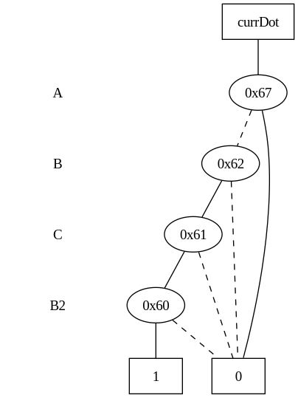
Concept
Goals of HW3 are:
Create BDD for given function or function of a cell using CUDD library
Levelize gatepins of the design using Toposort

Slide 3
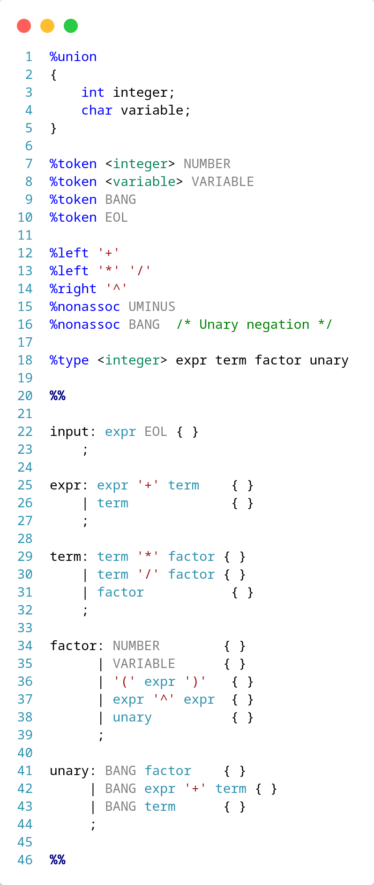
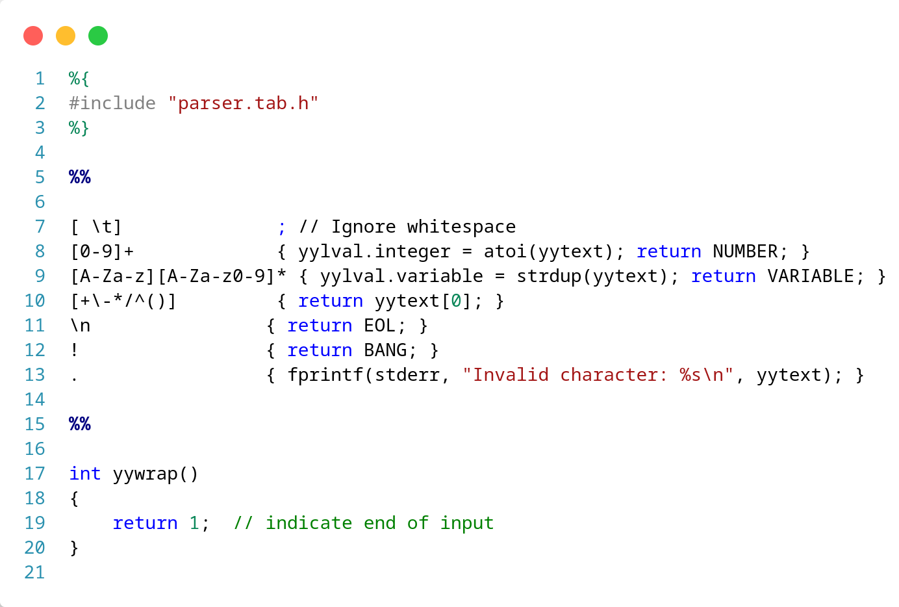
Parse Expression
To parse expression correctly we need to implement a flex and bison small parser with simple rules

Slide 4
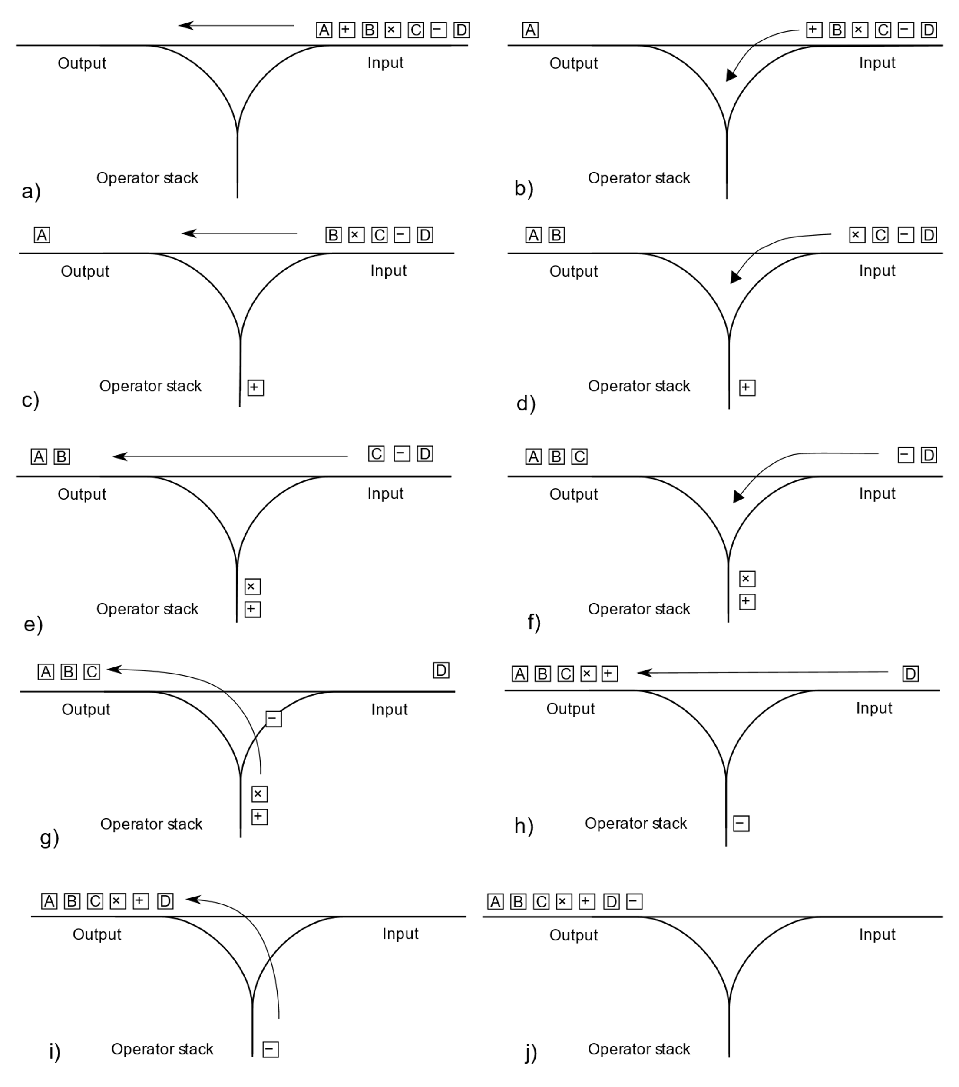
Convert Expression
It is necessary to convert the logic expression user gave us, from infix to postfix to be easier to analyze the expression
In order to achieve this we use Shunting yard algorithm
Example:
Infix: A+B*C*(D+A)
Postfix: ABC*DA+*+

Slide 5
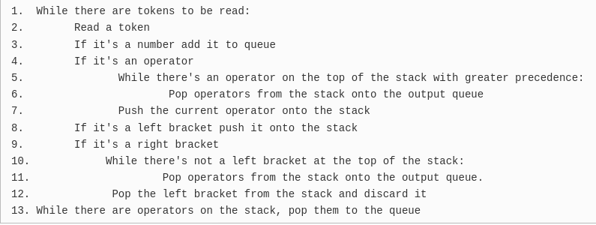
Convert Expression
To implement this algorithm, we need to create a stack of char* type.
We create basic functions for this like:
Create_stack
Push
Pop
Peek
IsEmpty
Delete_stack
Pseudo-code

Slide 6
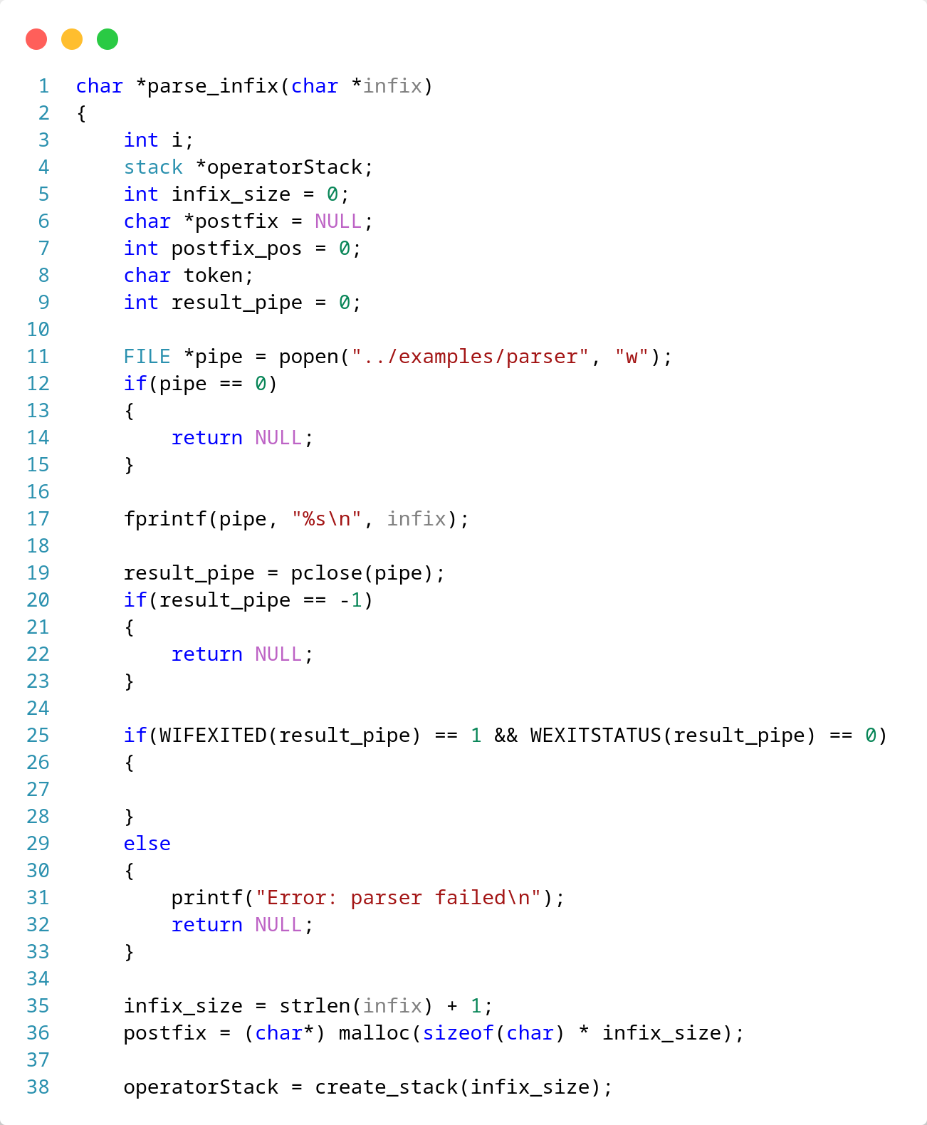
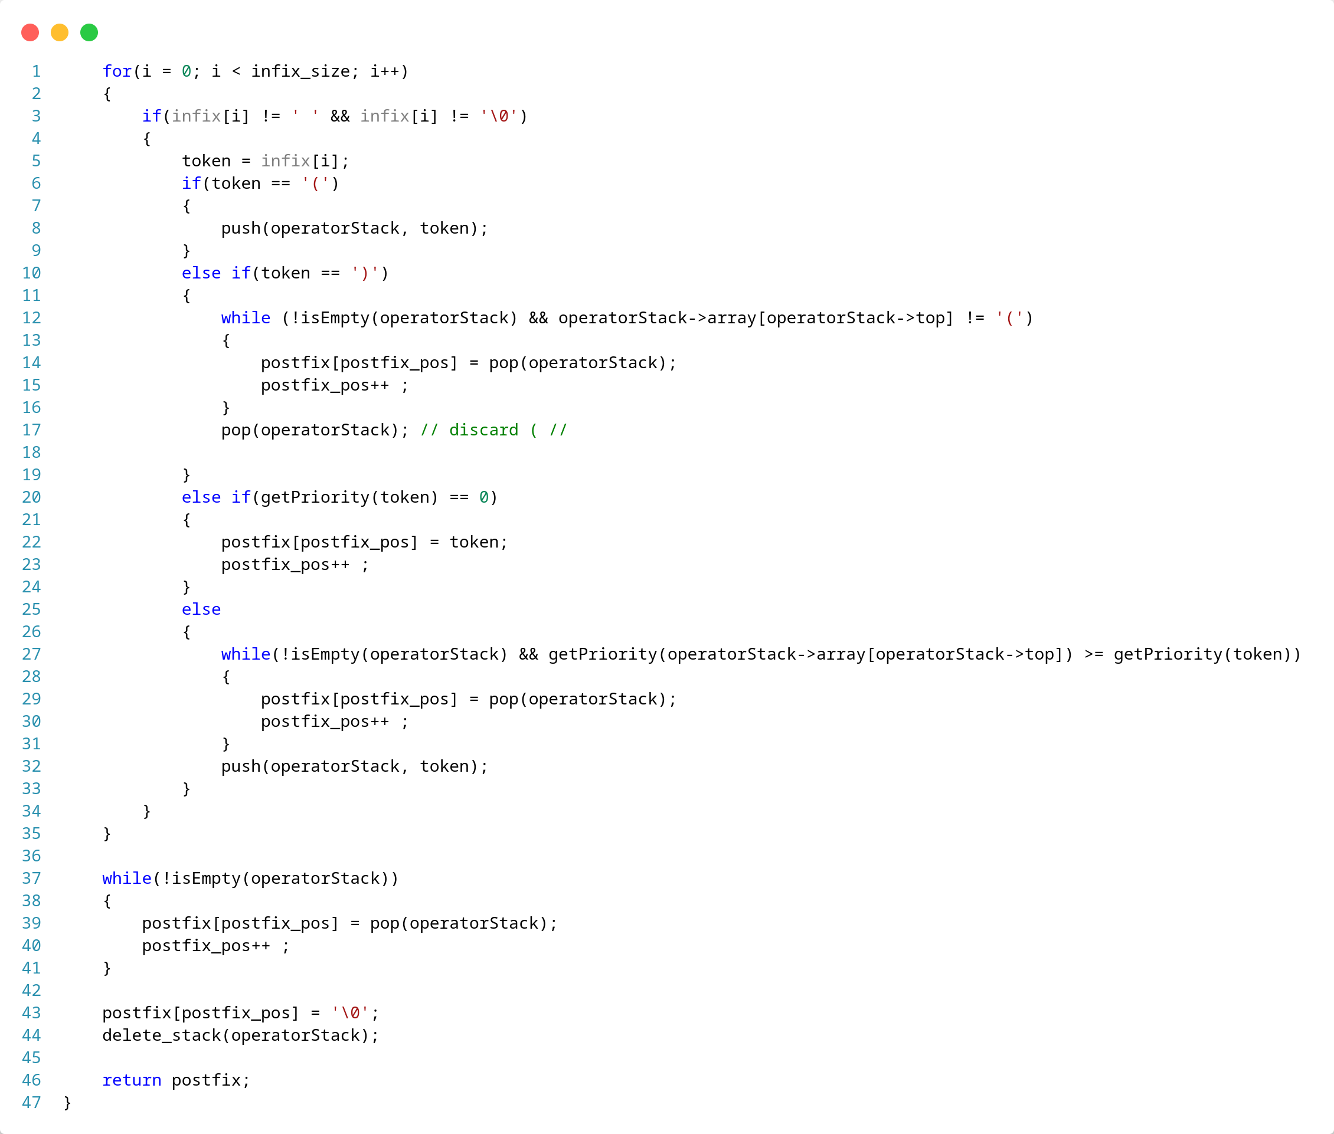
Convert Expression Code

Slide 7
Create BDD for an expression
Steps to create a BDD from Expression:
Convert infix to postfix
Keep array with variables Names (if a variable appears more than one time, just keep it once)
Keep size of this array
Add a sentinel "/" between variables in postfix expression and return it
Example:
Infix: A+B*C*(D+A)
Postfix: ABC*DA+*+
Postfix_new: A/B/C/*D/A/+*+
Array
A | B | C | D

Slide 8
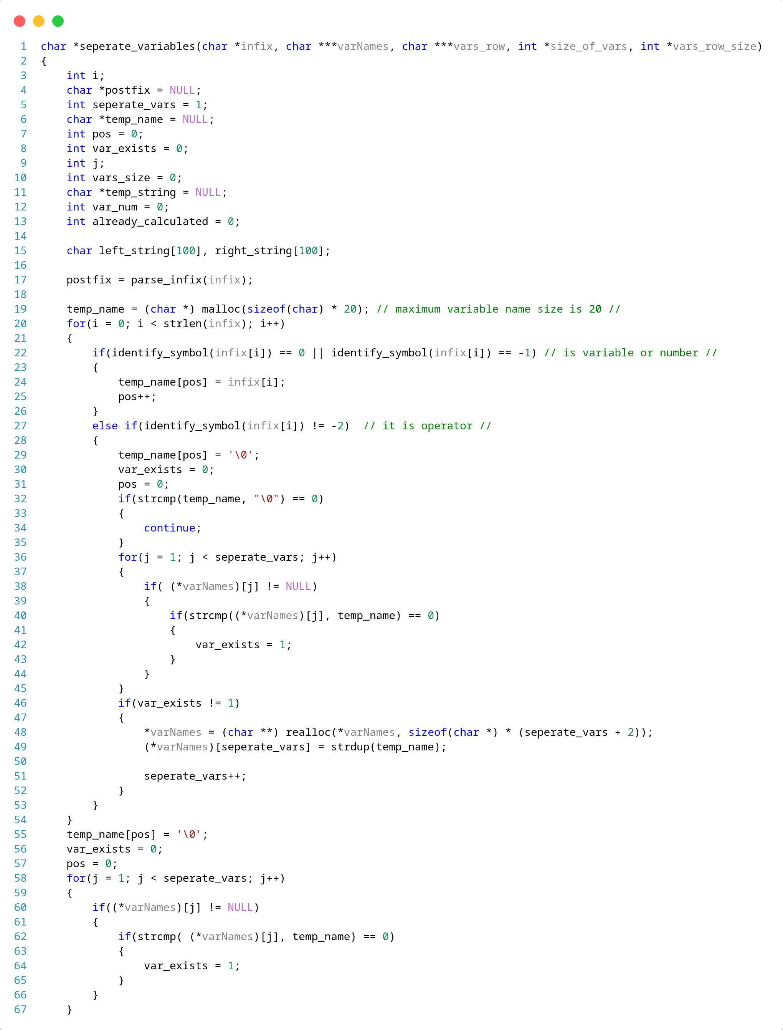
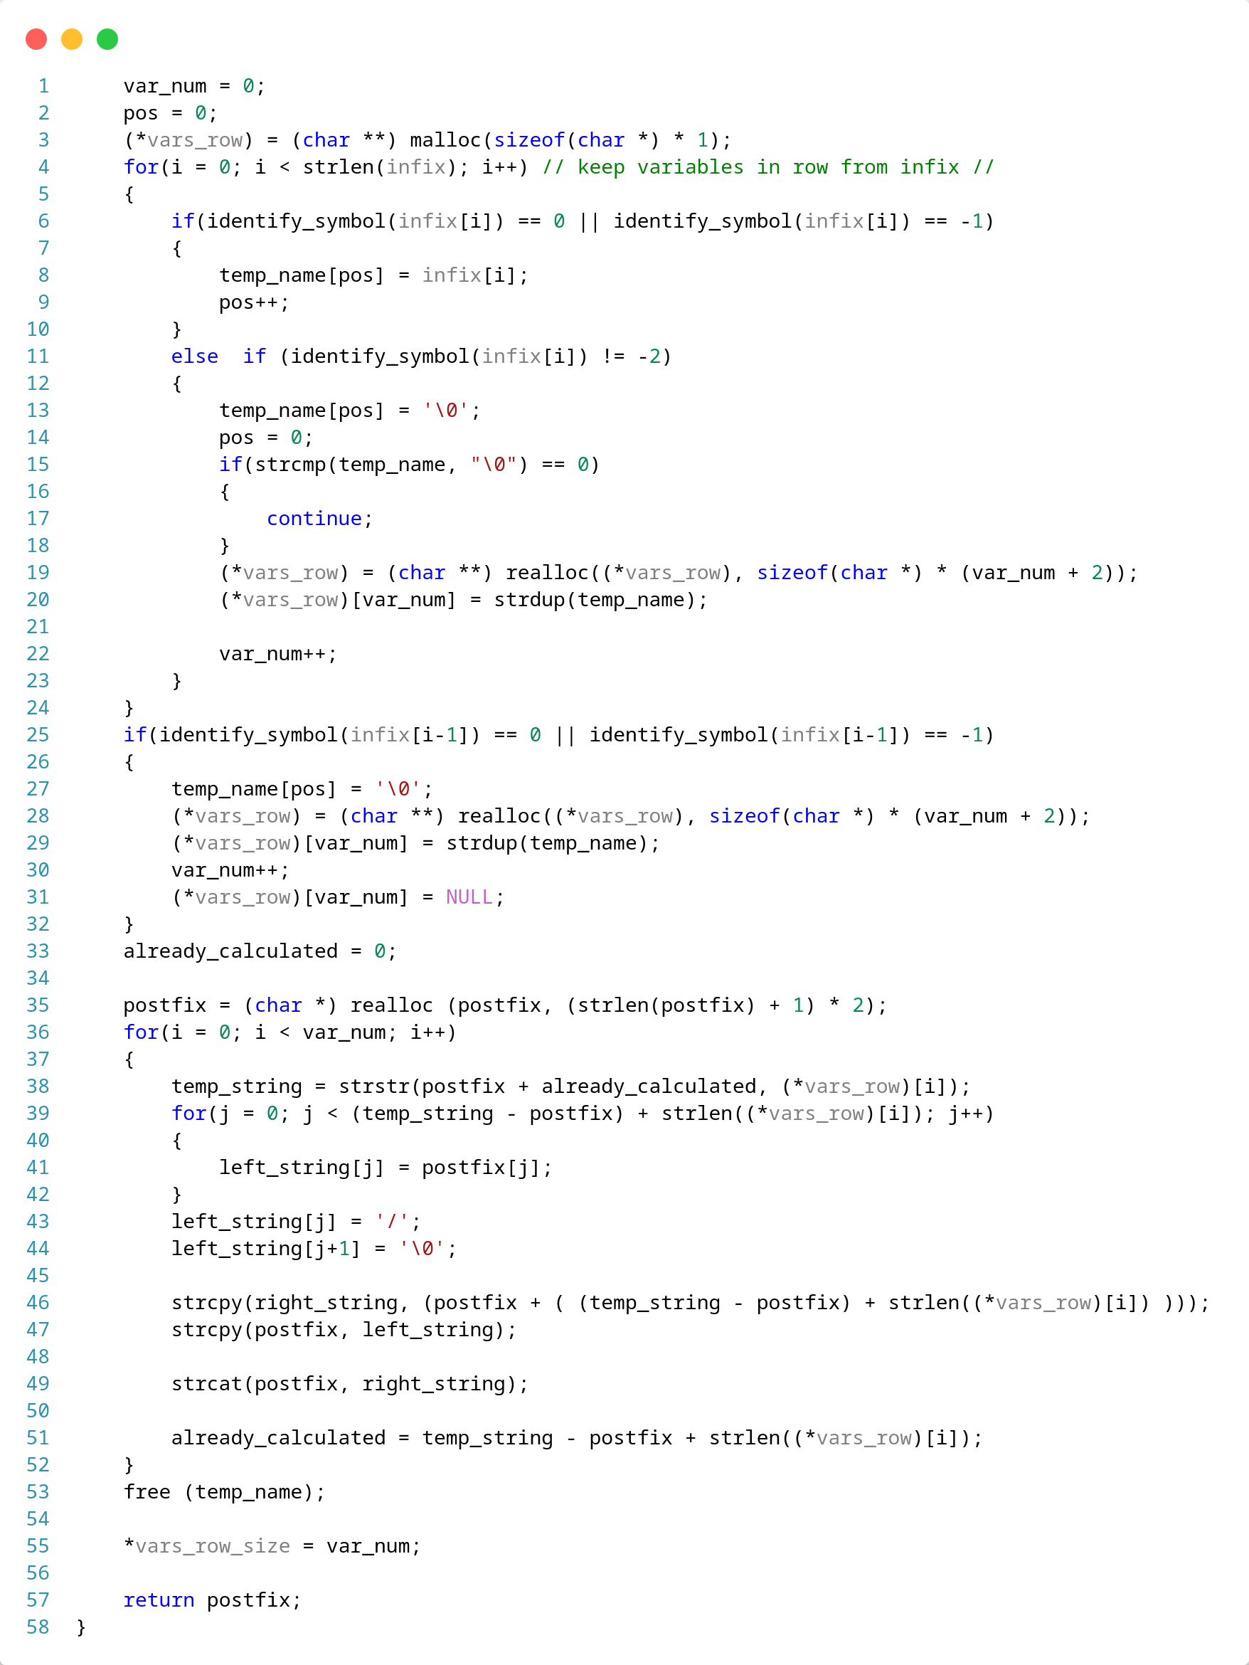
Create BDD for an expression

Slide 9
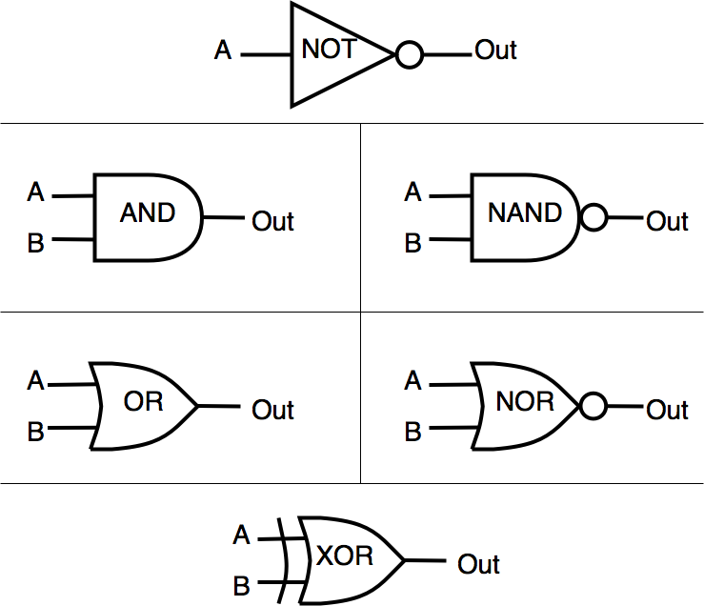
Create BDD for an expression
CUDD use
Create and init manager of package which keeps all infortmations about nodes connections etc
Each variable represents a DdNode which is a struct of package
We create one DdNode* for each seperate variable of expression
We use commands for each logic calculation between nodes
Cudd_bddAnd
Cudd_bddOr
Cudd_NOT
Cudd_bddXor

Slide 10
Create BDD for an expression
Steps to create a BDD from Expression:
We parse the postfix and when we find a variable we push it on stack.
When we find an operator we
Postfix_new: A/B/C/*D/A/+*+

Slide 11
Create BDD for an expression
A | B | C | D
A
Postfix_new: A/B/C/*D/A/+*+
Push(A)

Slide 12
Create BDD for an expression
A | B | C | D
B
A
Postfix_new: A/B/C/*D/A/+*+
Push(B)

Slide 13
Create BDD for an expression
A | B | C | D
C
B
A
Postfix_new: A/B/C/*D/A/+*+
Push(C)

Slide 14
Create BDD for an expression
BDD
A
Postfix_new: A/B/C/*D/A/+*+
Found operator
var_1 = pop()
var_2 = pop()
bdd = Cudd_bddAnd(gbm, var_1, var_2)
push(bdd)
C
B

Slide 15
Create BDD for an expression
A | B | C | D
D
BDD
A
Postfix_new: A/B/C/*D/A/+*+
push(D)

Slide 16
Create BDD for an expression
A | B | C | D
A
D
BDD
A
Postfix_new: A/B/C/*D/A/+*+
push(A)

Slide 17
Create BDD for an expression
BDD2
BDD
A
Postfix_new: A/B/C/*D/A/+*+
Found operator
var_1 = pop()
var_2 = pop() A D
bdd = Cudd_bddOr(gbm, var_1, var_2)
push(bdd)

Slide 18
Create BDD for an expression
BDD
A
Postfix_new: A/B/C/*D/A/+*+
Found operator
var_1 = pop()
var_2 = pop() BDD2 BDD
bdd = Cudd_bddAnd(gbm, var_1, var_2)
push(bdd)

Slide 19
Create BDD for an expression
BDD
Postfix_new: A/B/C/*D/A/+*+
Found operator
var_1 = pop()
var_2 = pop() BDD A
bdd = Cudd_bddAnd(gbm, var_1, var_2)
push(bdd)

Slide 20
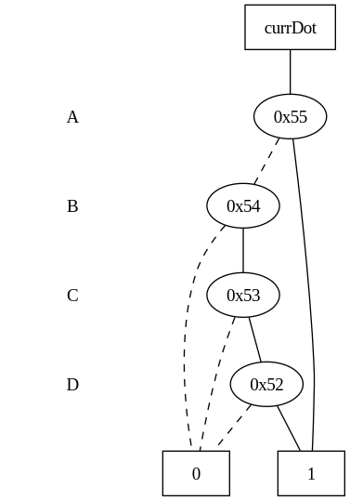
Create BDD for an expression
Postfix_new: A/B/C/*D/A/+*+
End of postfix
final_bdd = pop()

Slide 21
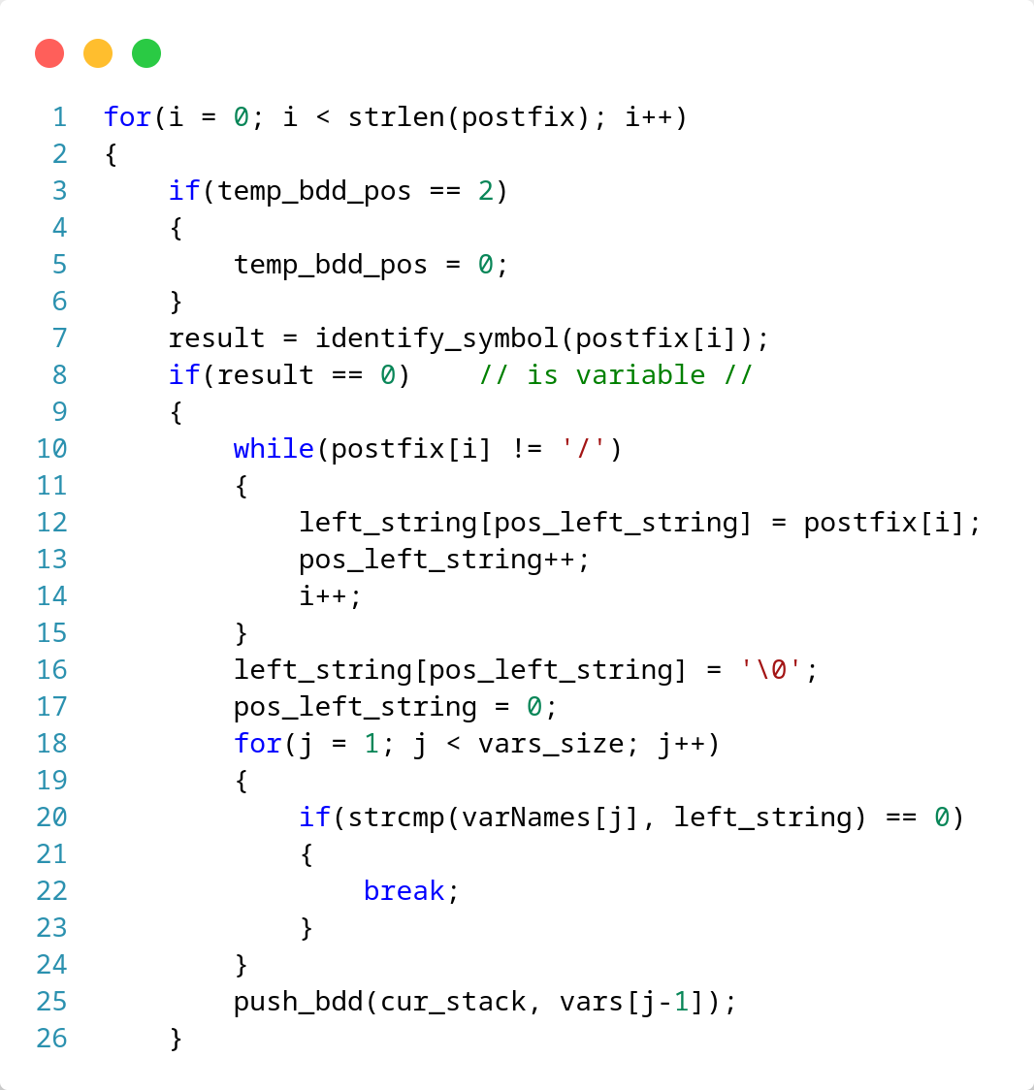
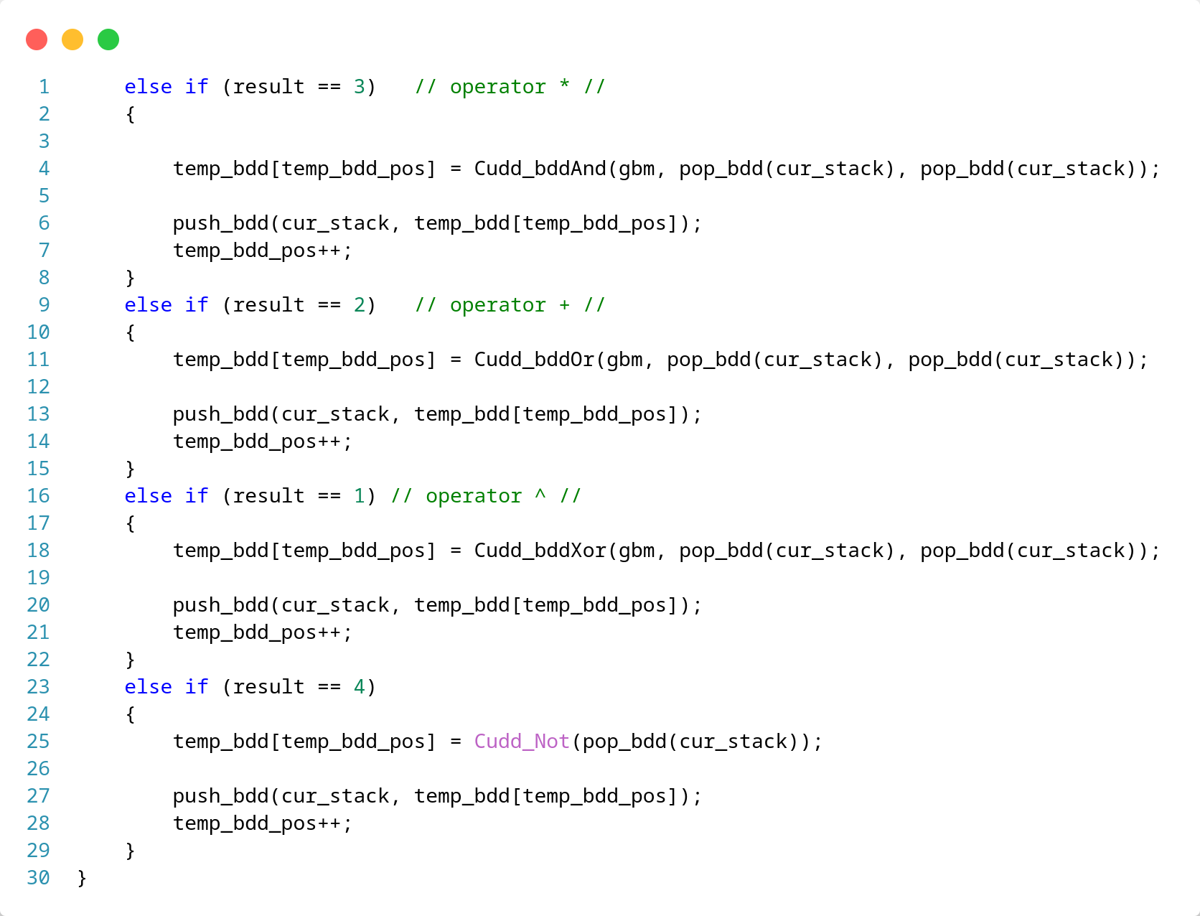

Slide 22
Create BDD for an expression
A+B*C*(D+A)
!A*B*(A+C*B2)
When bdd is ready, we call the function to get dot file and we convert it to image.
We convert BDD to ADD for better representation

Slide 23
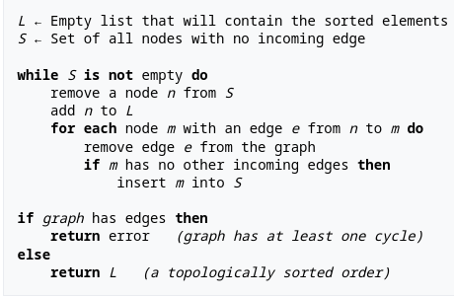
Toposort
Kahn’s Algorithm

Slide 24
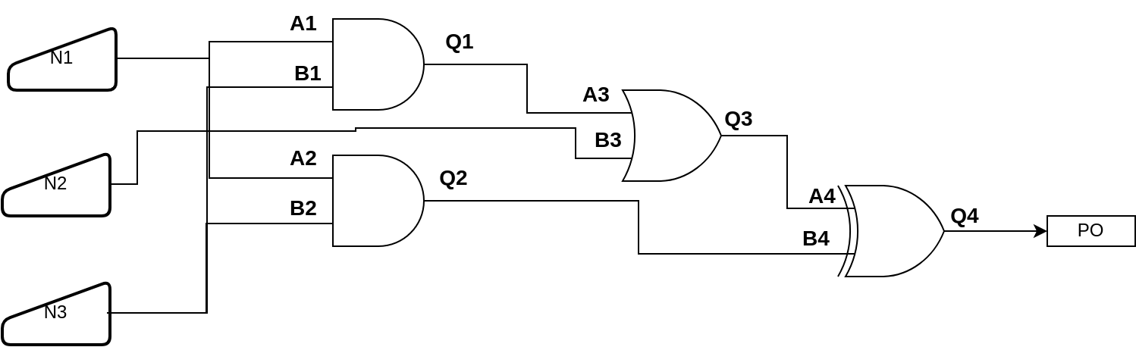
Toposort
Startpoints
N1 | N2 | N3

Slide 25
Toposort
S list
L list
N1 | N2 | N3

Slide 26
Toposort
S list
L list
N1 | N2
N3

Slide 27
Toposort
S list
L list
B2 | N1 | N2
N3

Slide 28
Toposort
S list
L list
B1 | B2 | N1 | N2
N3

Slide 29
Toposort
S list
L list
B1 | B2 | N1
N2 | N3

Slide 30
Toposort
S list
L list
B3 | B1 | B2 | N1
N2 | N3

Slide 31
Toposort
S list
L list
B3 | B1 | B2
N1 | N2 | N3

Slide 32
Toposort
S list
L list
A1 | B3 | B1 | B2
N1 | N2 | N3

Slide 33
Toposort
S list
L list
A2 | A1 | B3 | B1 | B2
N1 | N2 | N3

Slide 34
Toposort
S list
L list
A2 | A1 | B3 | B1
B2 | N1 | N2 | N3
Make B2 visited
Check if Q2 has all predecessors visited (Fail)

Slide 35
Toposort
S list
L list
A2 | A1 | B3
B1 | B2 | N1 | N2 | N3
Make B1 visited
Check if Q1 has all predecessors visited (Fail)

Slide 36
Toposort
S list
L list
A2 | A1
B3 | B1 | B2 | N1 | N2 | N3
Make B3 visited
Check if Q3 has all predecessors visited (Fail)

Slide 37
Toposort
S list
L list
Q1 | A2
A1 | B3 | B1 | B2 | N1 | N2 | N3
Make A1 visited
Check if Q1 has all predecessors visited (check)

Slide 38
Toposort
S list
L list
Q2 | Q1
A2 | A1 | B3 | B1 | B2 | N1 | N2 | N3
Make A2 visited
Check if Q2 has all predecessors visited (check)

Slide 39
Toposort
S list
L list
Q2
Q1 | A2 | A1 | B3 | B1 | B2 | N1 | N2 | N3
Make Q1 visited

Slide 40
Toposort
S list
L list
A3 | Q2
Q1 | A2 | A1 | B3 | B1 | B2 | N1 | N2 | N3

Slide 41
Toposort
S list
A3
L list
Q2 | Q1 | A2 | A1 | B3 | B1 | B2 | N1 | N2 | N3
Make Q2 visited

Slide 42
Toposort
S list
B4 | A3
L list
Q2 | Q1 | A2 | A1 | B3 | B1 | B2 | N1 | N2 | N3

Slide 43
Toposort
S list
Q3 | B4
L list
A3 | Q2 | Q1 | A2 | A1 | B3 | B1 | B2 | N1 | N2 | N3
Make A3 visited
Check if Q3 has all predecessors visited (check)

Slide 44
Toposort
S list
Q3
L list
B4 | A3 | Q2 | Q1 | A2 | A1 | B3 | B1 | B2 | N1 | N2 | N3
Make B4 visited
Check if Q4 has all predecessors visited (fail)

Slide 45
Toposort
S list
L list
Q3 | B4 | A3 | Q2 | Q1 | A2 | A1 | B3 | B1 | B2 | N1 | N2 | N3
Make Q3 visited

Slide 46
Toposort
S list
A4
L list
Q3 | B4 | A3 | Q2 | Q1 | A2 | A1 | B3 | B1 | B2 | N1 | N2 | N3

Slide 47
Toposort
S list
Q4
L list
A4 | Q3 | B4 | A3 | Q2 | Q1 | A2 | A1 | B3 | B1 | B2 | N1 | N2 | N3
Make A4 visited
Check if Q4 has all predecessors visited (check)

Slide 48
Toposort
S list
L list
Q4 | A4 | Q3 | B4 | A3 | Q2 | Q1 | A2 | A1 | B3 | B1 | B2 | N1 | N2 | N3
Make Q4 visited

Slide 49
Toposort
S list
L list
PO | Q4 | A4 | Q3 | B4 | A3 | Q2 | Q1 | A2 | A1 | B3 | B1 | B2 | N1 | N2 | N3
Primary Output, add it to L list

Slide 50
Toposort
S list
L list
PO | Q4 | A4 | Q3 | B4 | A3 | Q2 | Q1 | A2 | A1 | B3 | B1 | B2 | N1 | N2 | N3
S is empty so algorithm exits

Slide 51
Toposort
PO | Q4 | A4 | Q3 | B4 | A3 | Q2 | Q1 | A2 | A1 | B3 | B1 | B2 | N1 | N2 | N3
 |  |  |  |  |  |  |  |  |  |  |  |  |  |  | 0
Level = 0

Slide 52
Toposort
PO | Q4 | A4 | Q3 | B4 | A3 | Q2 | Q1 | A2 | A1 | B3 | B1 | B2 | N1 | N2 | N3
 |  |  |  |  |  |  |  |  |  |  |  |  |  | 0 | 0
Level = 0

Slide 53
Toposort
PO | Q4 | A4 | Q3 | B4 | A3 | Q2 | Q1 | A2 | A1 | B3 | B1 | B2 | N1 | N2 | N3
 |  |  |  |  |  |  |  |  |  |  |  |  | 0 | 0 | 0
Level = 0

Slide 54
Toposort
PO | Q4 | A4 | Q3 | B4 | A3 | Q2 | Q1 | A2 | A1 | B3 | B1 | B2 | N1 | N2 | N3
 |  |  |  |  |  |  |  |  |  |  |  | 1 | 0 | 0 | 0
Level = 1

Slide 55
Toposort
PO | Q4 | A4 | Q3 | B4 | A3 | Q2 | Q1 | A2 | A1 | B3 | B1 | B2 | N1 | N2 | N3
 |  |  |  |  |  |  |  |  |  |  | 1 | 1 | 0 | 0 | 0
Level = 1

Slide 56
Toposort
PO | Q4 | A4 | Q3 | B4 | A3 | Q2 | Q1 | A2 | A1 | B3 | B1 | B2 | N1 | N2 | N3
 |  |  |  |  |  |  |  |  |  | 1 | 1 | 1 | 0 | 0 | 0
Level = 1

Slide 57
Toposort
PO | Q4 | A4 | Q3 | B4 | A3 | Q2 | Q1 | A2 | A1 | B3 | B1 | B2 | N1 | N2 | N3
 |  |  |  |  |  |  |  |  | 1 | 1 | 1 | 1 | 0 | 0 | 0
Level = 1

Slide 58
Toposort
PO | Q4 | A4 | Q3 | B4 | A3 | Q2 | Q1 | A2 | A1 | B3 | B1 | B2 | N1 | N2 | N3
 |  |  |  |  |  |  |  | 1 | 1 | 1 | 1 | 1 | 0 | 0 | 0
Level = 1

Slide 59
Toposort
PO | Q4 | A4 | Q3 | B4 | A3 | Q2 | Q1 | A2 | A1 | B3 | B1 | B2 | N1 | N2 | N3
 |  |  |  |  |  |  | 2 | 1 | 1 | 1 | 1 | 1 | 0 | 0 | 0
Found output +1
Level = 2

Slide 60
Toposort
PO | Q4 | A4 | Q3 | B4 | A3 | Q2 | Q1 | A2 | A1 | B3 | B1 | B2 | N1 | N2 | N3
 |  |  |  |  |  | 2 | 2 | 1 | 1 | 1 | 1 | 1 | 0 | 0 | 0
Level = 2

Slide 61
PO | Q4 | A4 | Q3 | B4 | A3 | Q2 | Q1 | A2 | A1 | B3 | B1 | B2 | N1 | N2 | N3
 |  |  |  |  | 3 | 2 | 2 | 1 | 1 | 1 | 1 | 1 | 0 | 0 | 0
Found Input, + 1
Level = 3

Slide 62
PO | Q4 | A4 | Q3 | B4 | A3 | Q2 | Q1 | A2 | A1 | B3 | B1 | B2 | N1 | N2 | N3
 |  |  |  | 3 | 3 | 2 | 2 | 1 | 1 | 1 | 1 | 1 | 0 | 0 | 0
Level = 3

Slide 63
PO | Q4 | A4 | Q3 | B4 | A3 | Q2 | Q1 | A2 | A1 | B3 | B1 | B2 | N1 | N2 | N3
 |  |  | 4 | 3 | 3 | 2 | 2 | 1 | 1 | 1 | 1 | 1 | 0 | 0 | 0
Found Output, +1
Level = 4

Slide 64
PO | Q4 | A4 | Q3 | B4 | A3 | Q2 | Q1 | A2 | A1 | B3 | B1 | B2 | N1 | N2 | N3
 |  | 5 | 4 | 3 | 3 | 2 | 2 | 1 | 1 | 1 | 1 | 1 | 0 | 0 | 0
Found Input, +1
Level = 5

Slide 65
PO | Q4 | A4 | Q3 | B4 | A3 | Q2 | Q1 | A2 | A1 | B3 | B1 | B2 | N1 | N2 | N3
 | 6 | 5 | 4 | 3 | 3 | 2 | 2 | 1 | 1 | 1 | 1 | 1 | 0 | 0 | 0
Found Output, +1
Level = 6

Slide 66
PO | Q4 | A4 | Q3 | B4 | A3 | Q2 | Q1 | A2 | A1 | B3 | B1 | B2 | N1 | N2 | N3
7 | 6 | 5 | 4 | 3 | 3 | 2 | 2 | 1 | 1 | 1 | 1 | 1 | 0 | 0 | 0
Found PO, +1
Level = 7

Slide 67
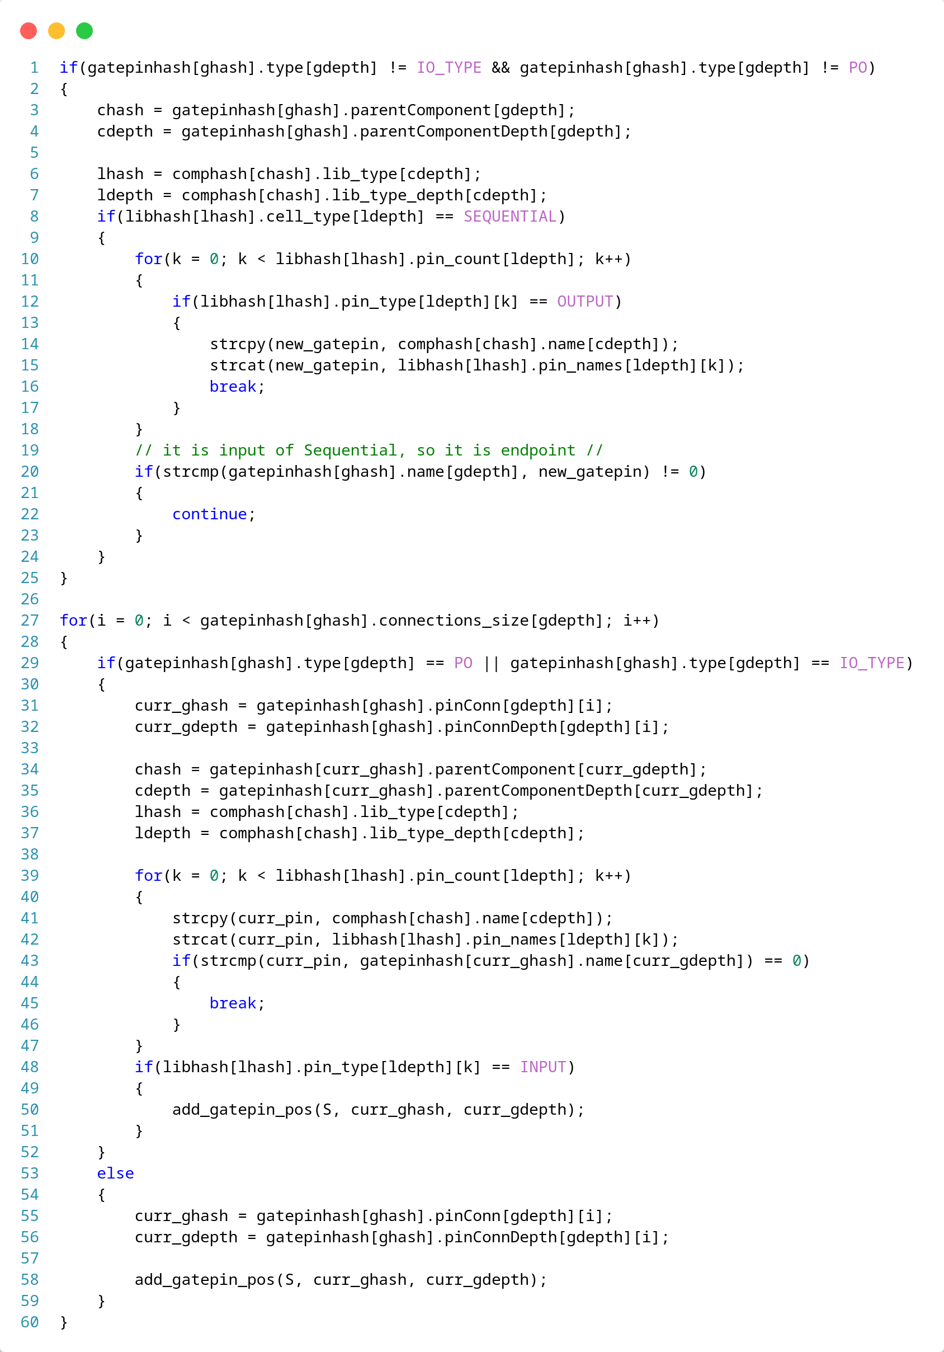
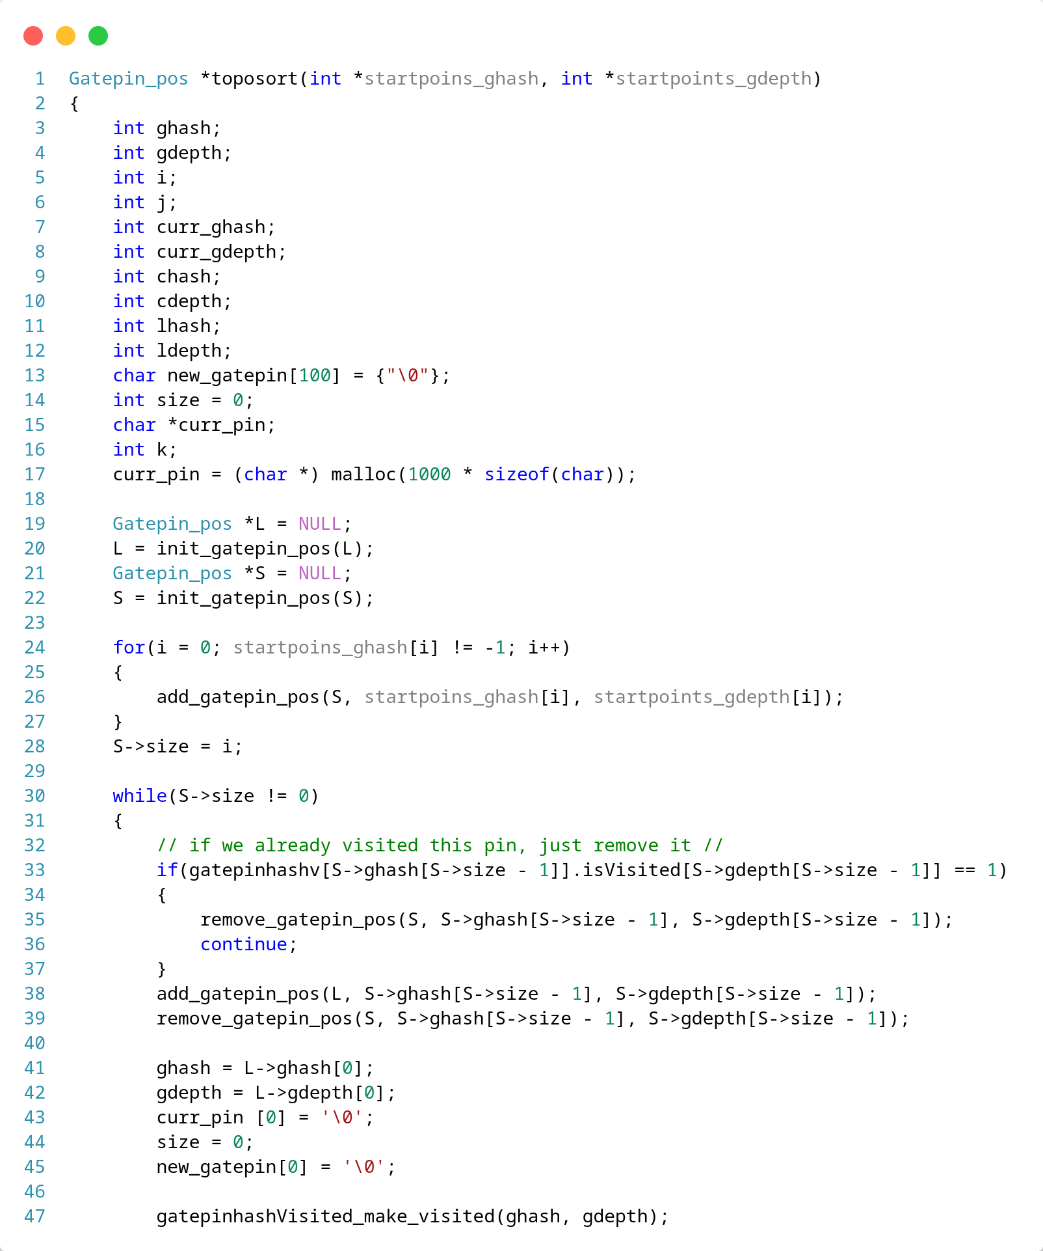
toposort()

Slide 68
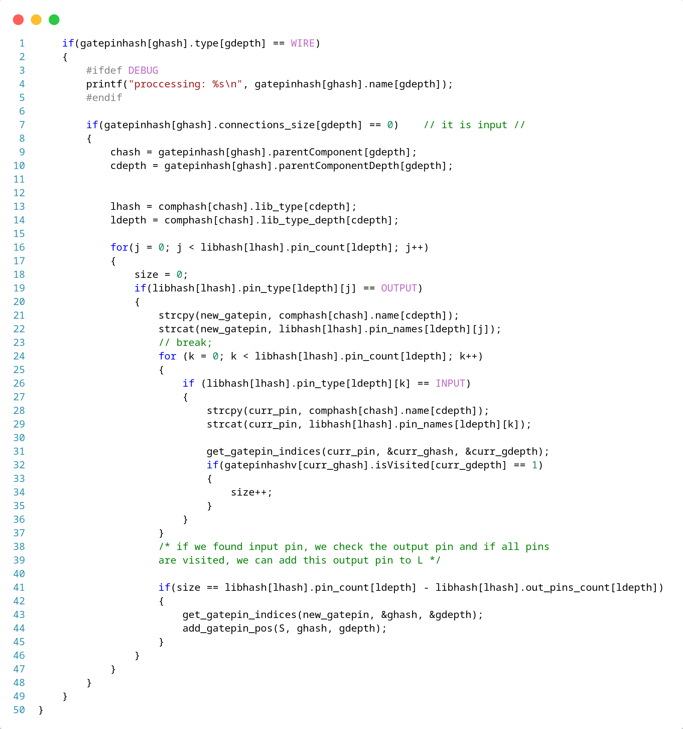
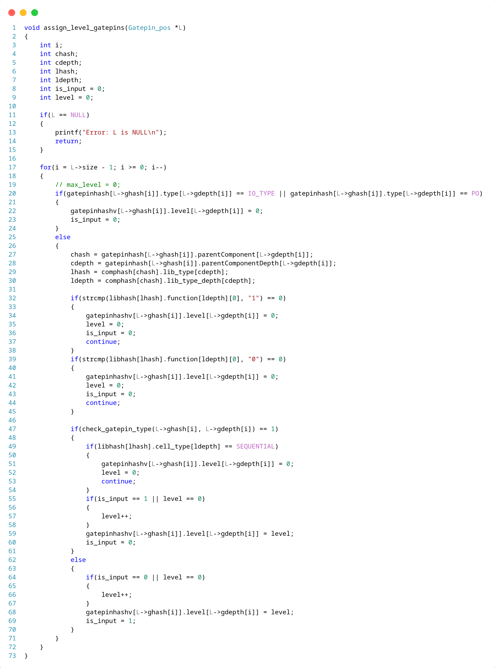
assign_levels()

Slide 69
Supported TCL Commands
report_library_cell_BDD “cell name”
report_component_BDD “component name”
compute expression_BDD “boolean expression”
report_gatepin_level “gatepin name”
report_gatepins_levelized
repor t_level_gatepins “level”

Slide 70
Demo for HW3
Wrong expression format
Compute random expressions
load design
report_BDD_gatepin
report_cell_BDD
get_toposort
report_gatepins_levelized
report_level_gatepins “level”

Slide 71
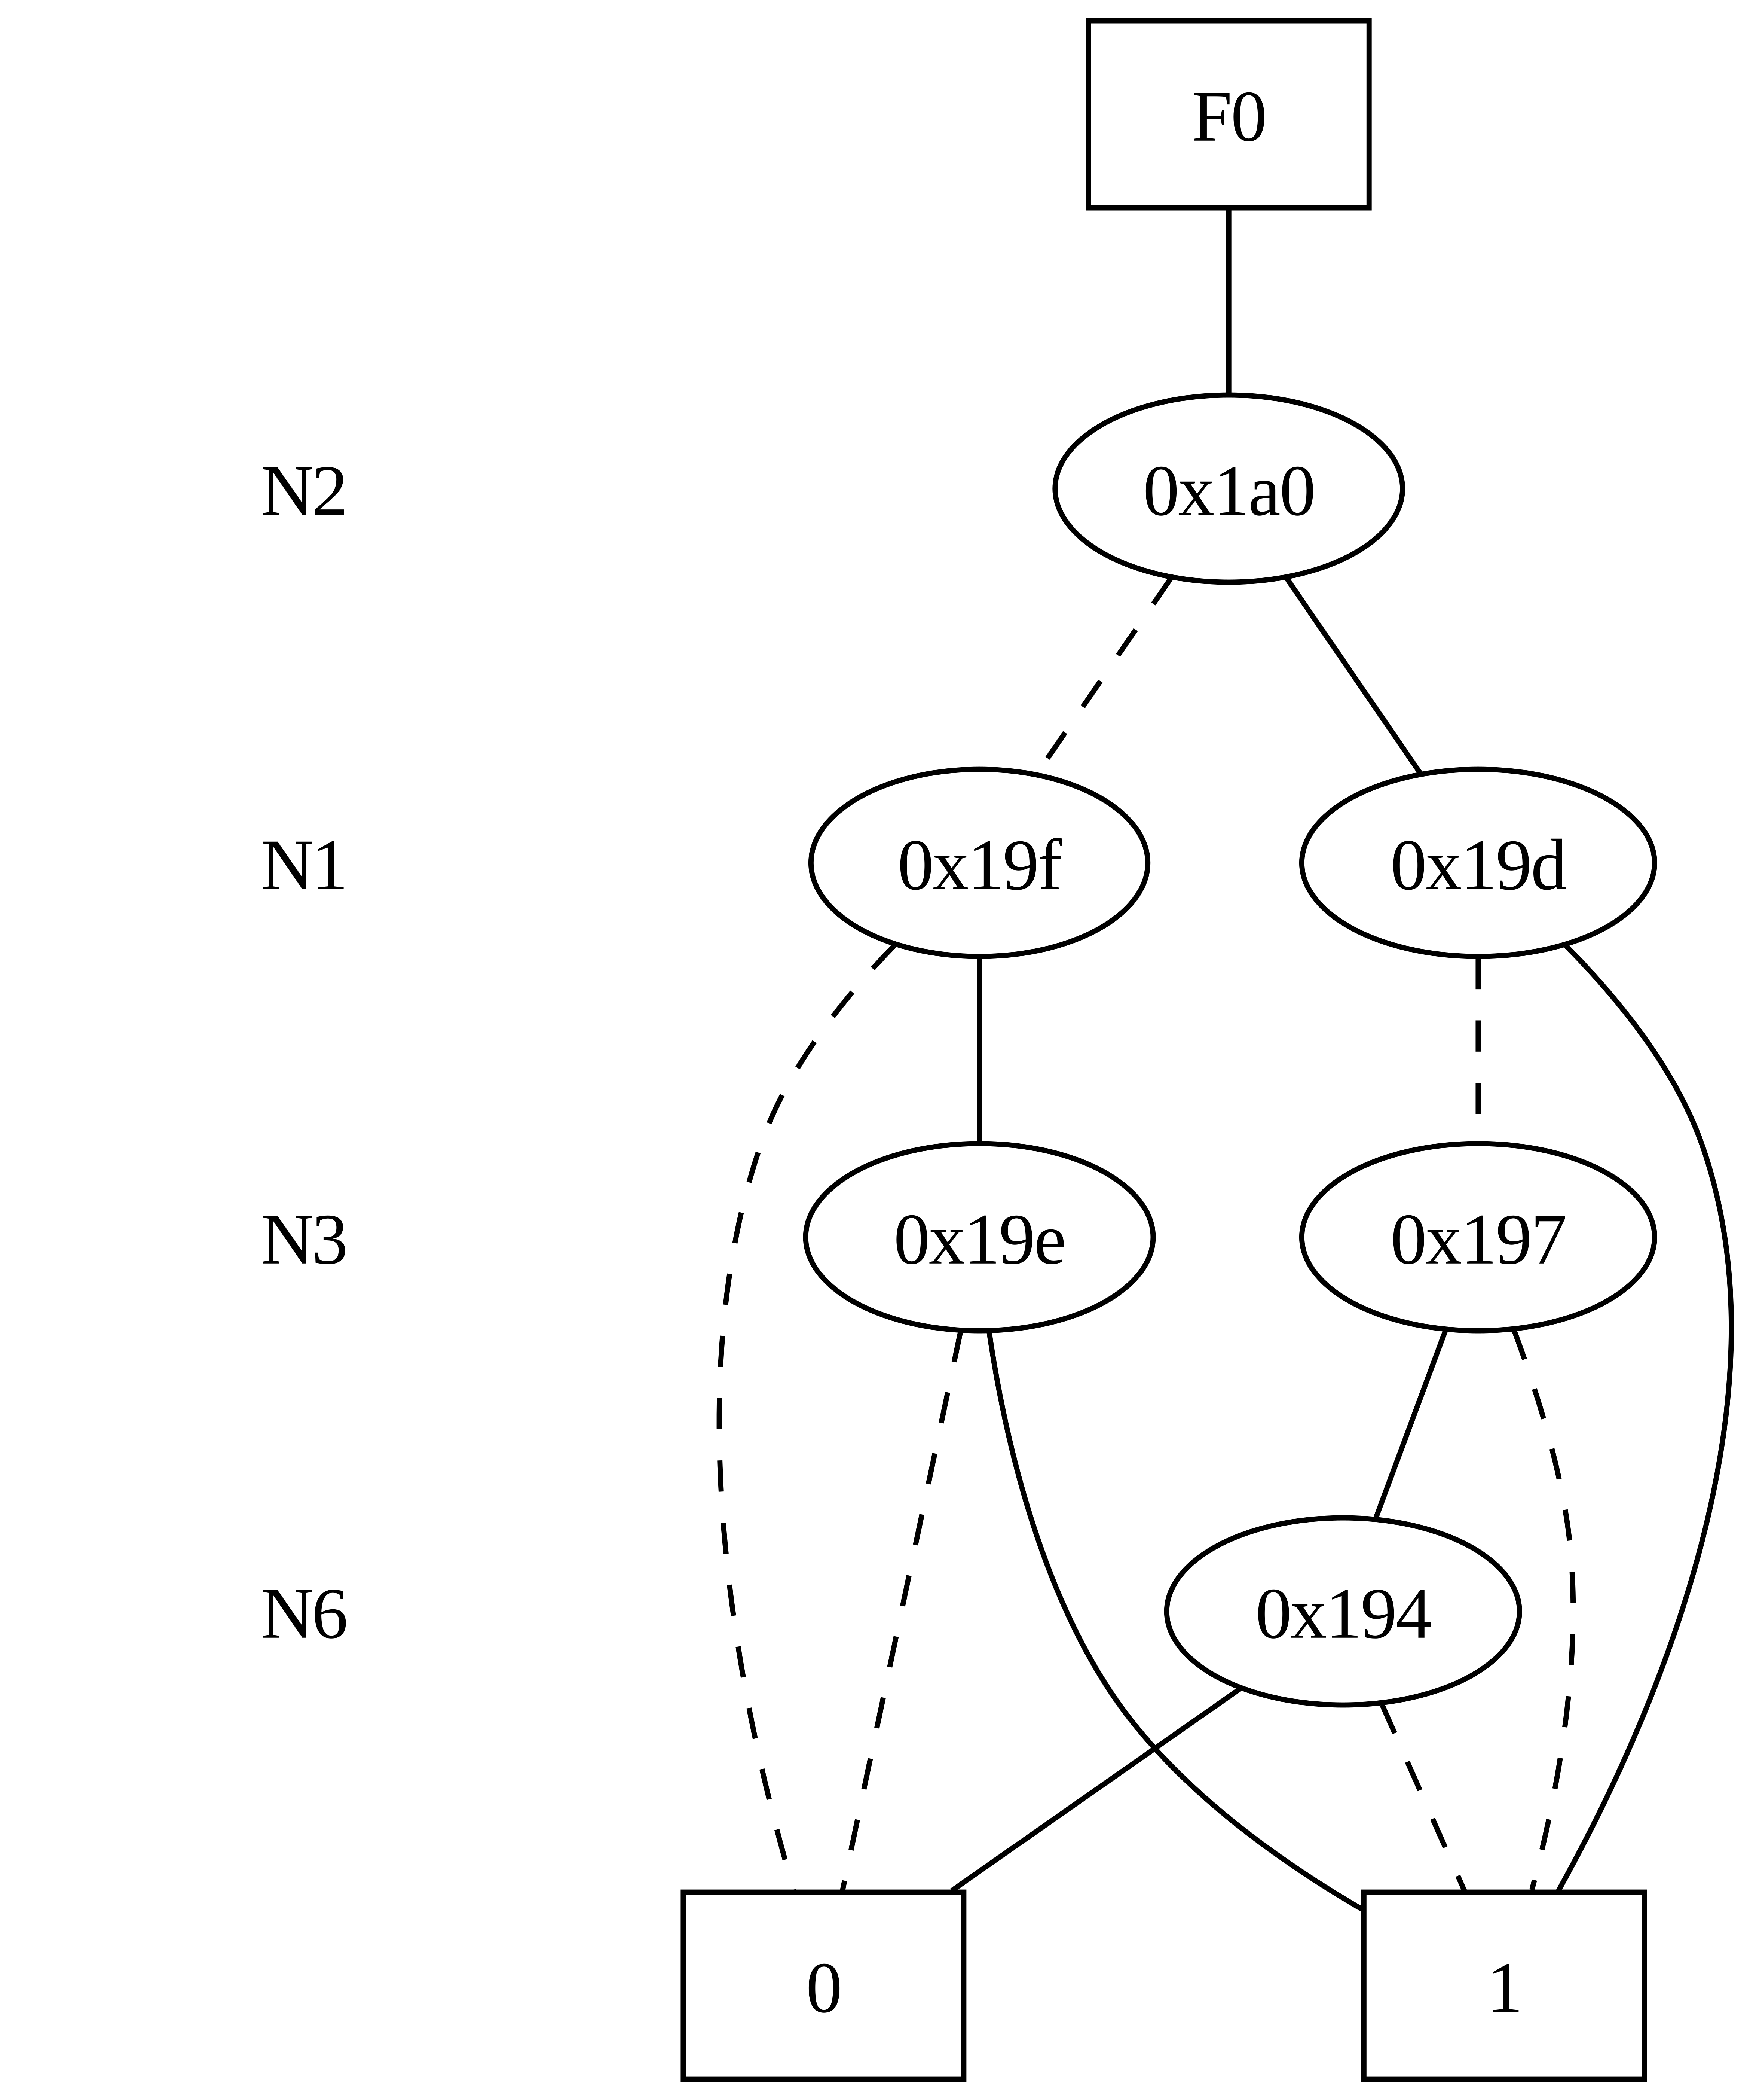
Concept
Goals of HW4 are:
Part A: BDD Construction for each Circuit Instance
Part B: Static Probabilities Annotation

Slide 72
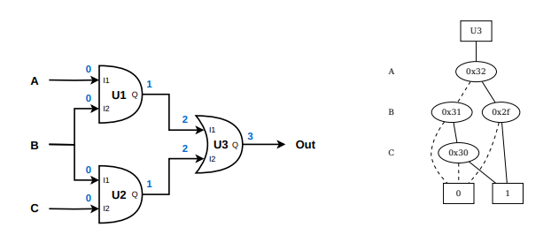
BDD Construction for each Circuit Instance
We need to concat BDDs of each cell to create a new one for each gatepin

Slide 73
BDD Construction for each Circuit Instance
Steps:
Design is levelized from toposort algorithm
We create DdNodes for all Startpoints and we keep an array of them
For cells logic-1 and logic-0 we annotate them as constant 1 and 0
We parse gatepins from level 1 to max level and we get from its cell the function to calculate postfix and to keep variables like HW3
Then for each input pin of cell we get its predecessor and if it is Startpoint we search it on the array to get the correct DdNode, else we get the BDD from predecessor output pin
Then, we call the function that creates BDDs and we add to it the two DdNodes that we need to concat
Then ReduceHeap and move to next gatepin

Slide 74
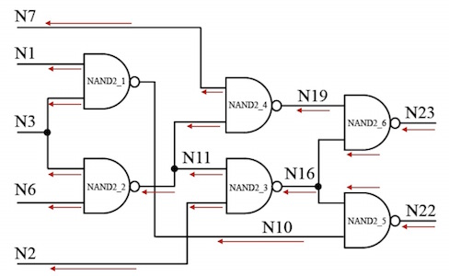
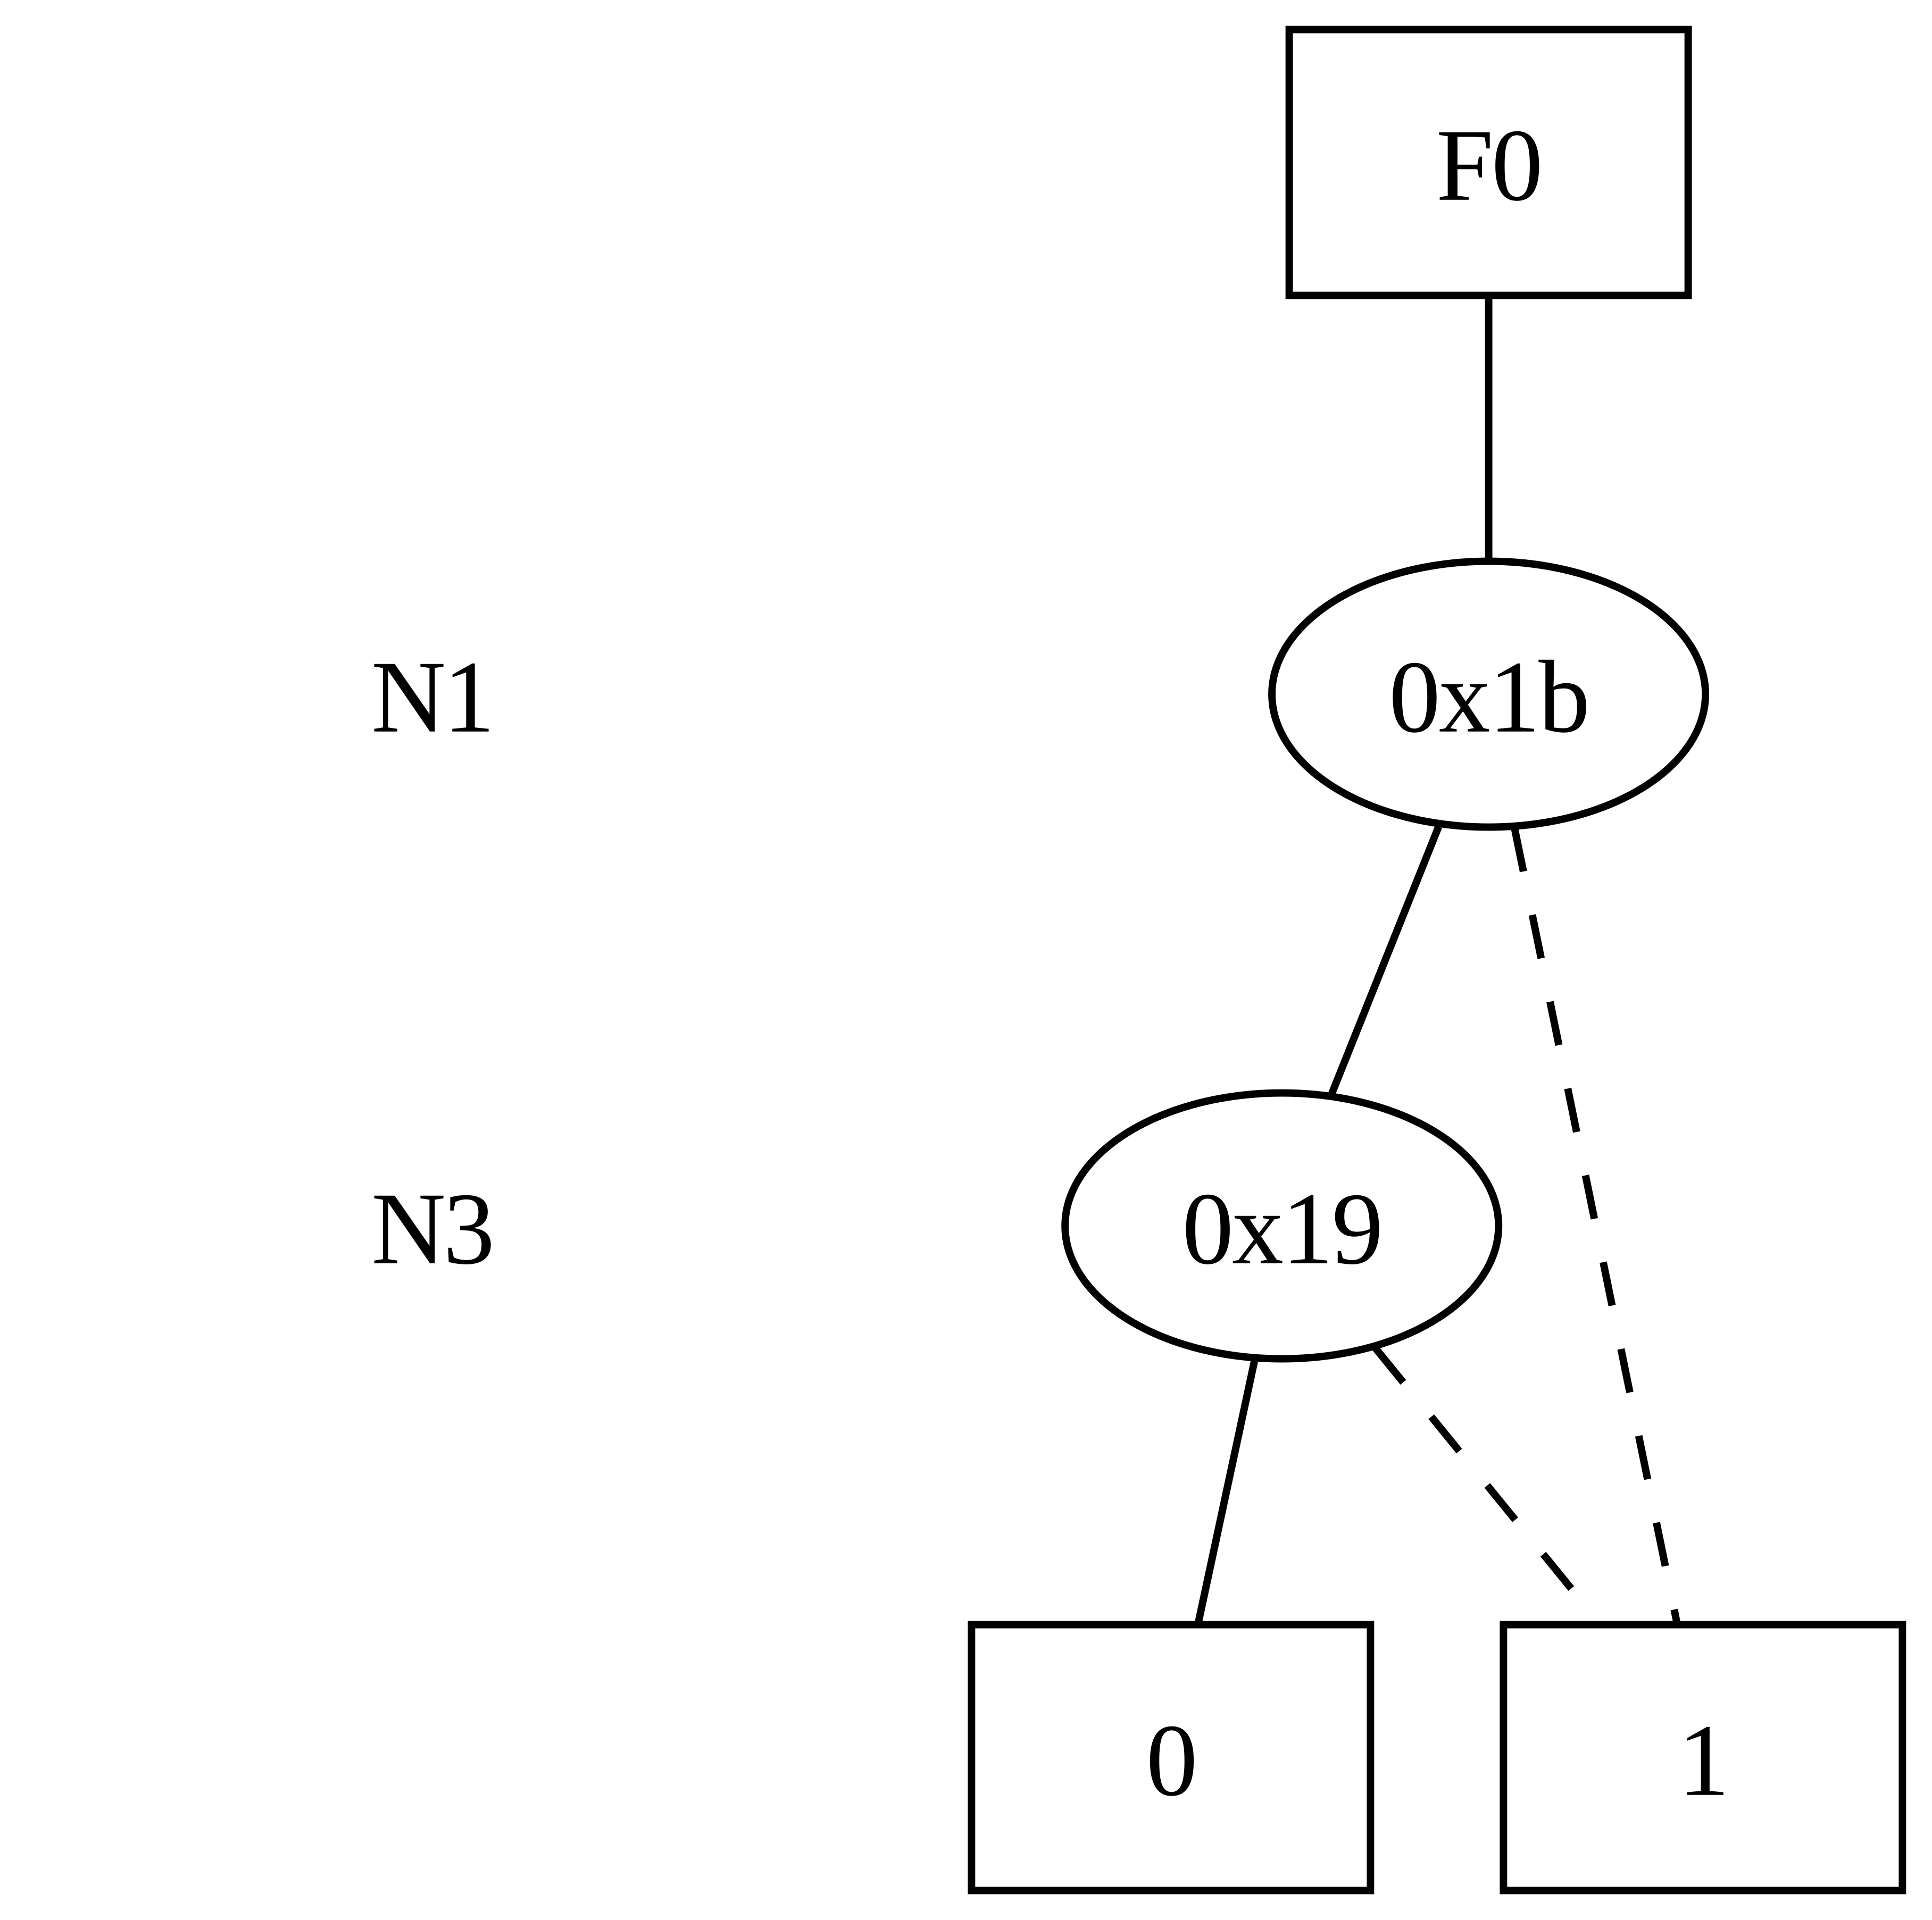
Example for design C17
Q1
Q1
Q3
Q4
Q2

Slide 75

Example for design C17
Q2
Q1
Q3
Q4
Q2

Slide 76
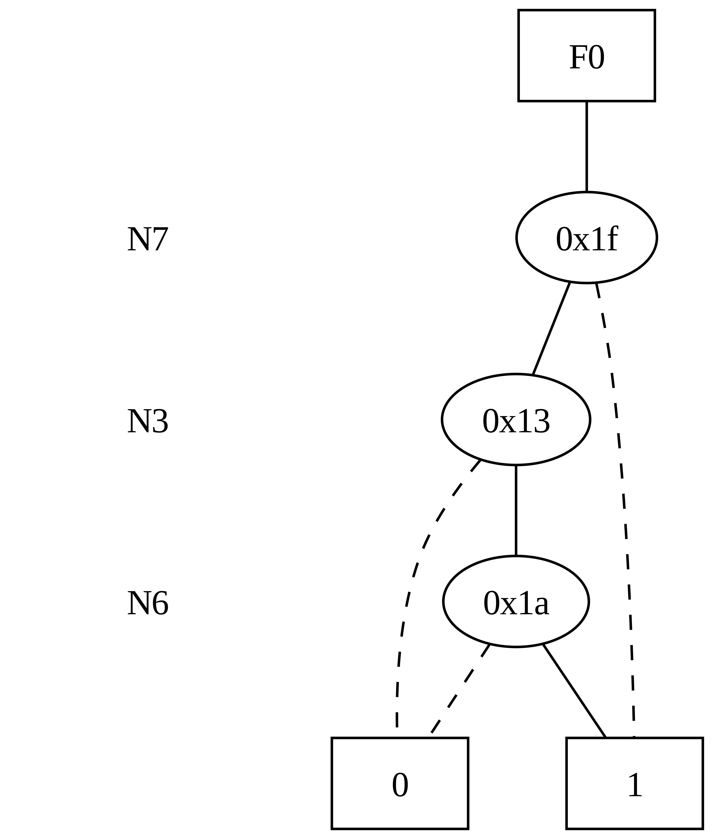
Q1
+
N7
Q3
Q3

Slide 77

Q2
N2
+
Q4
Q4

Slide 78
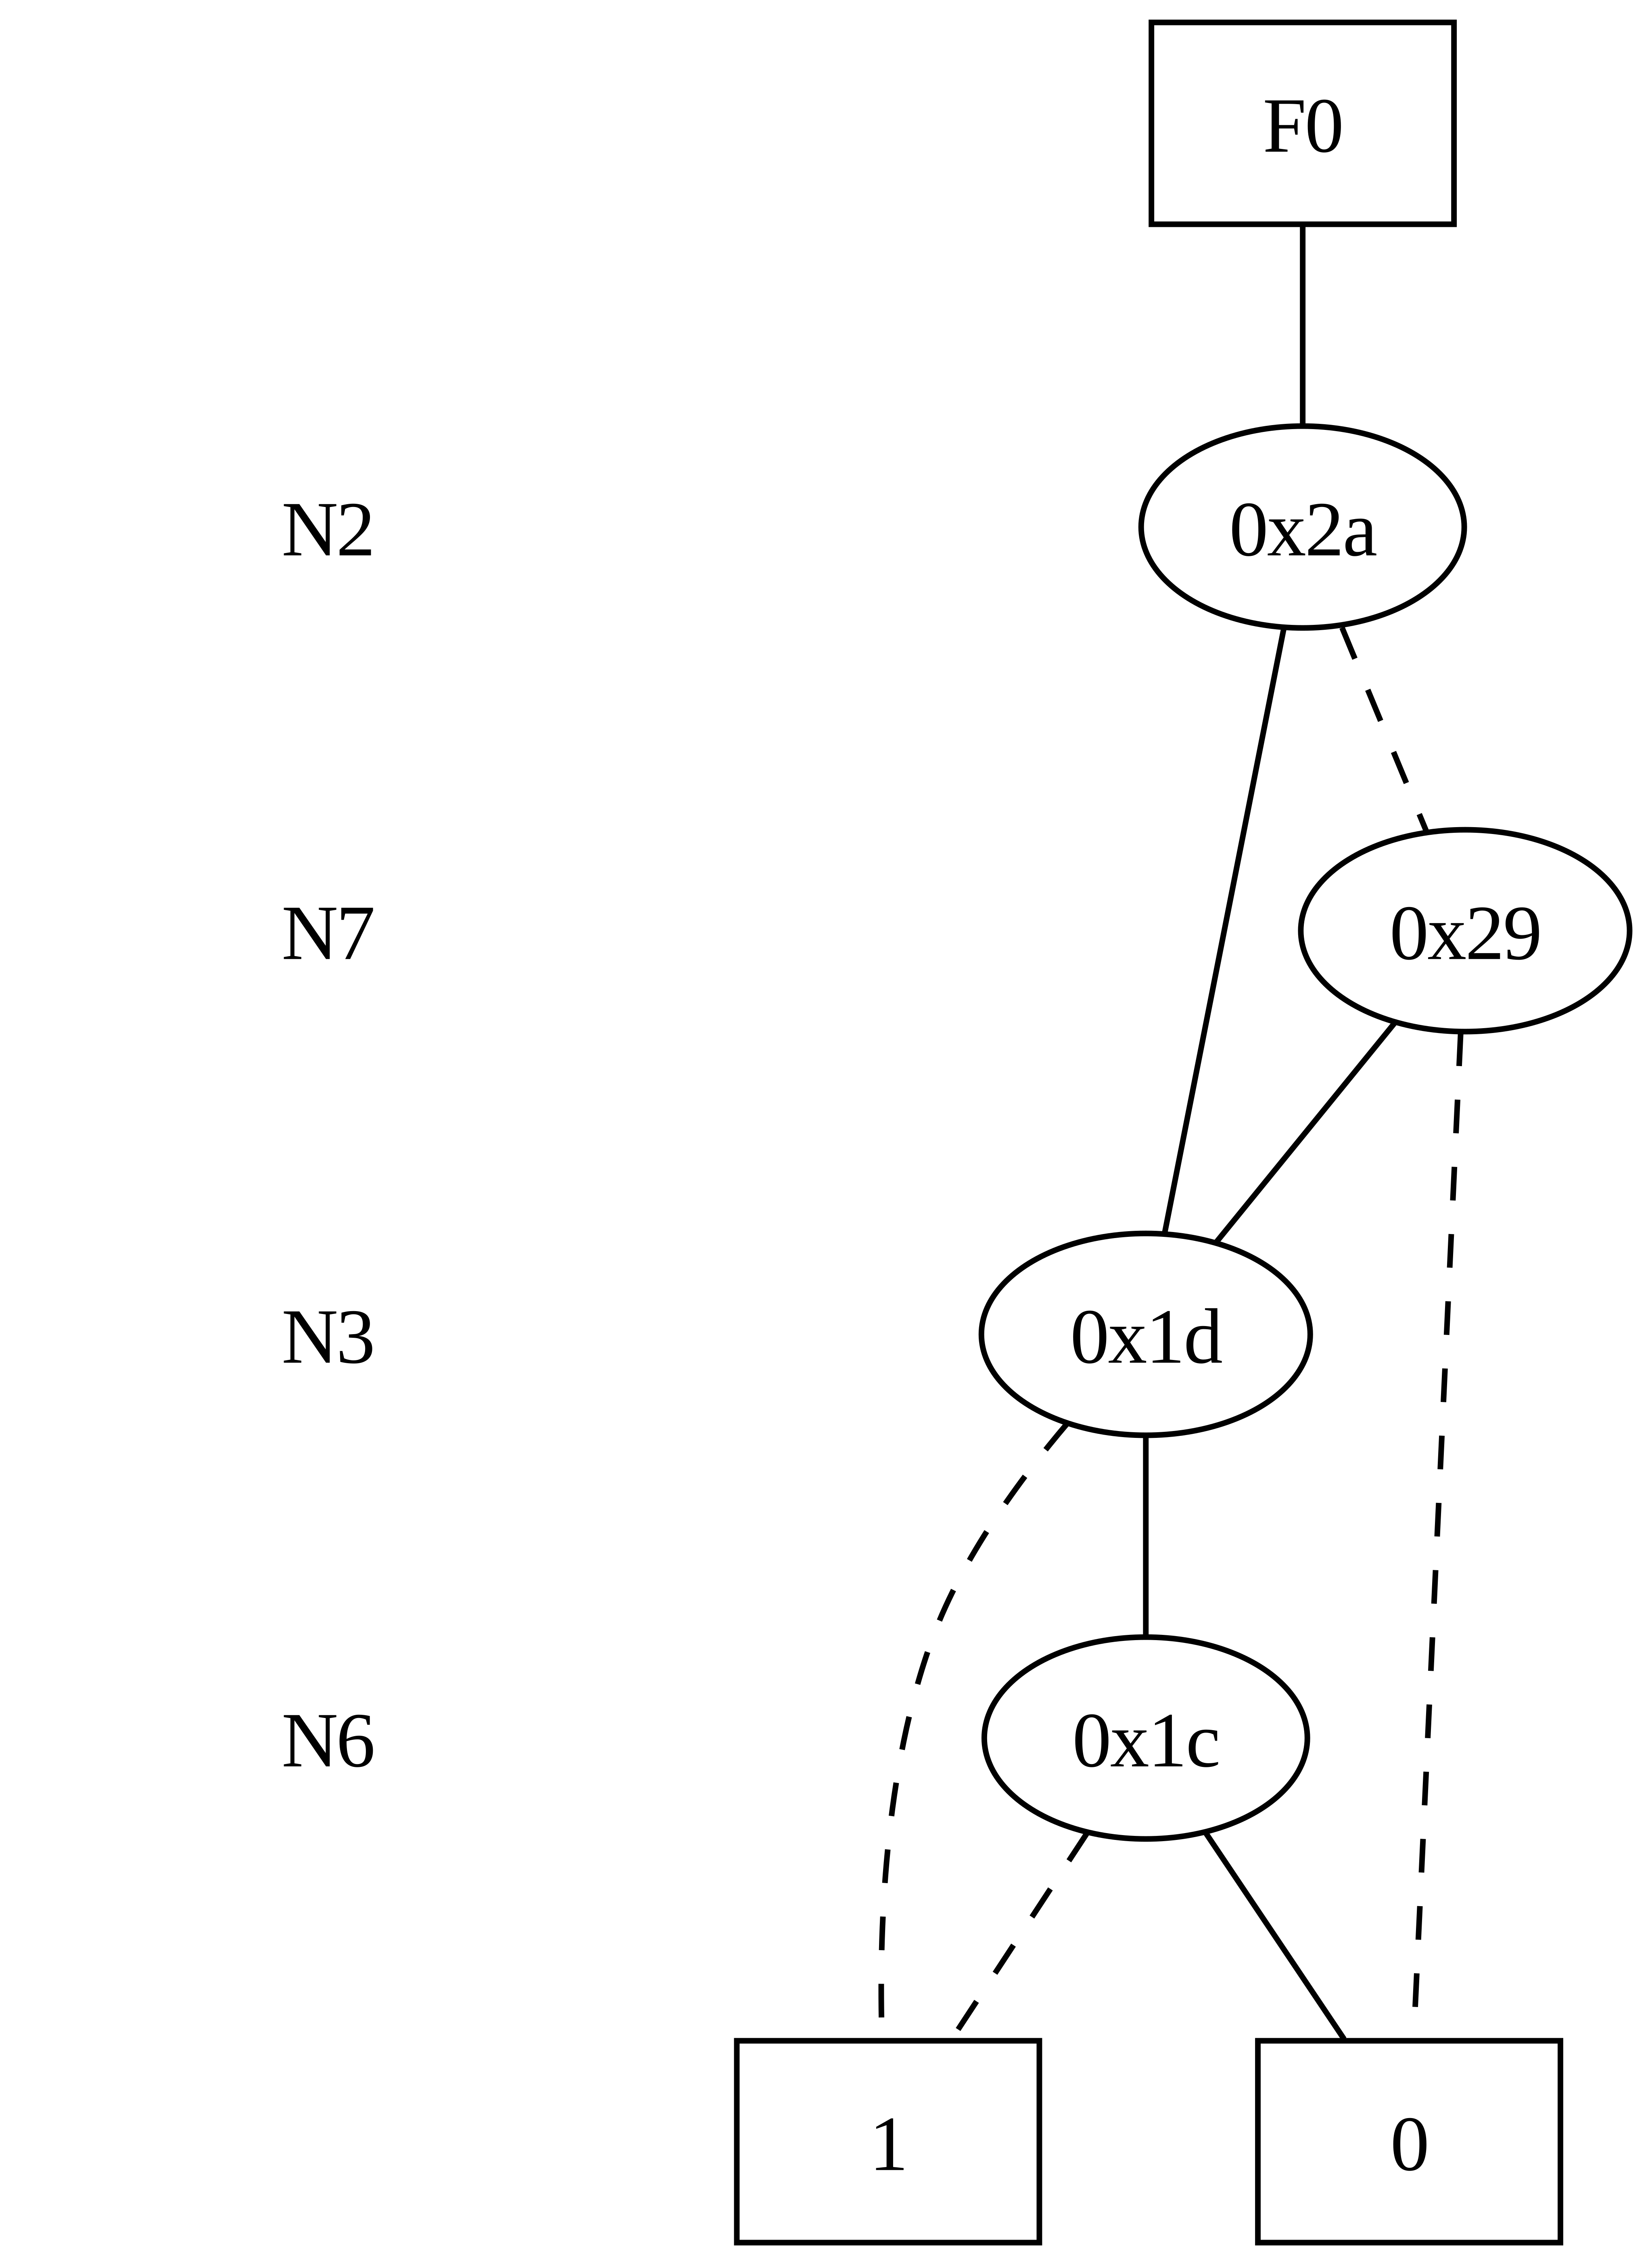
Q3
Q4
+
N23

Slide 79
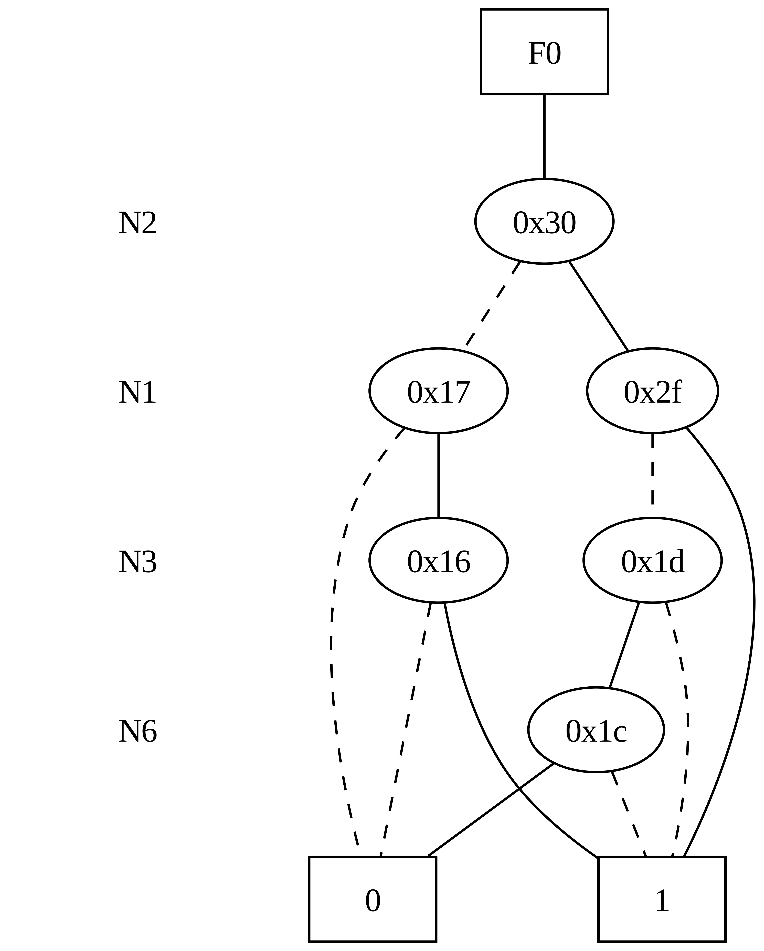
Q1
Q4
+
N22

Slide 80
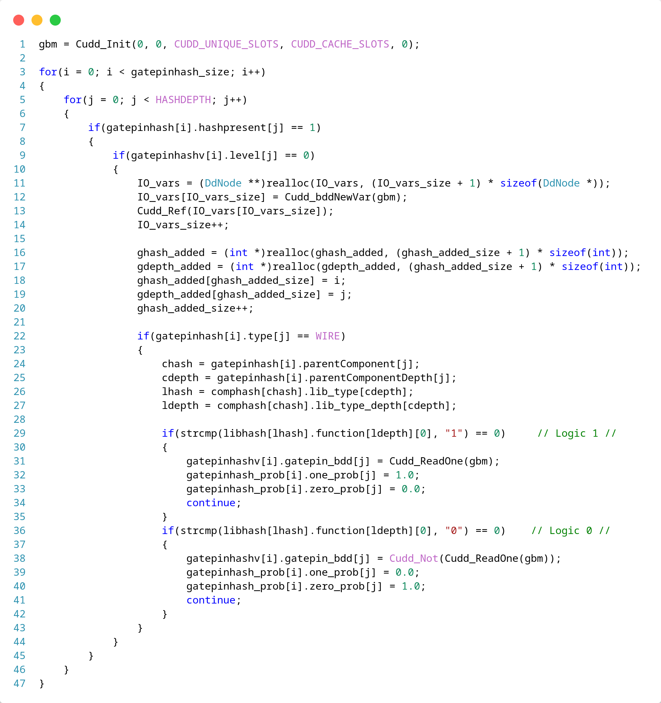
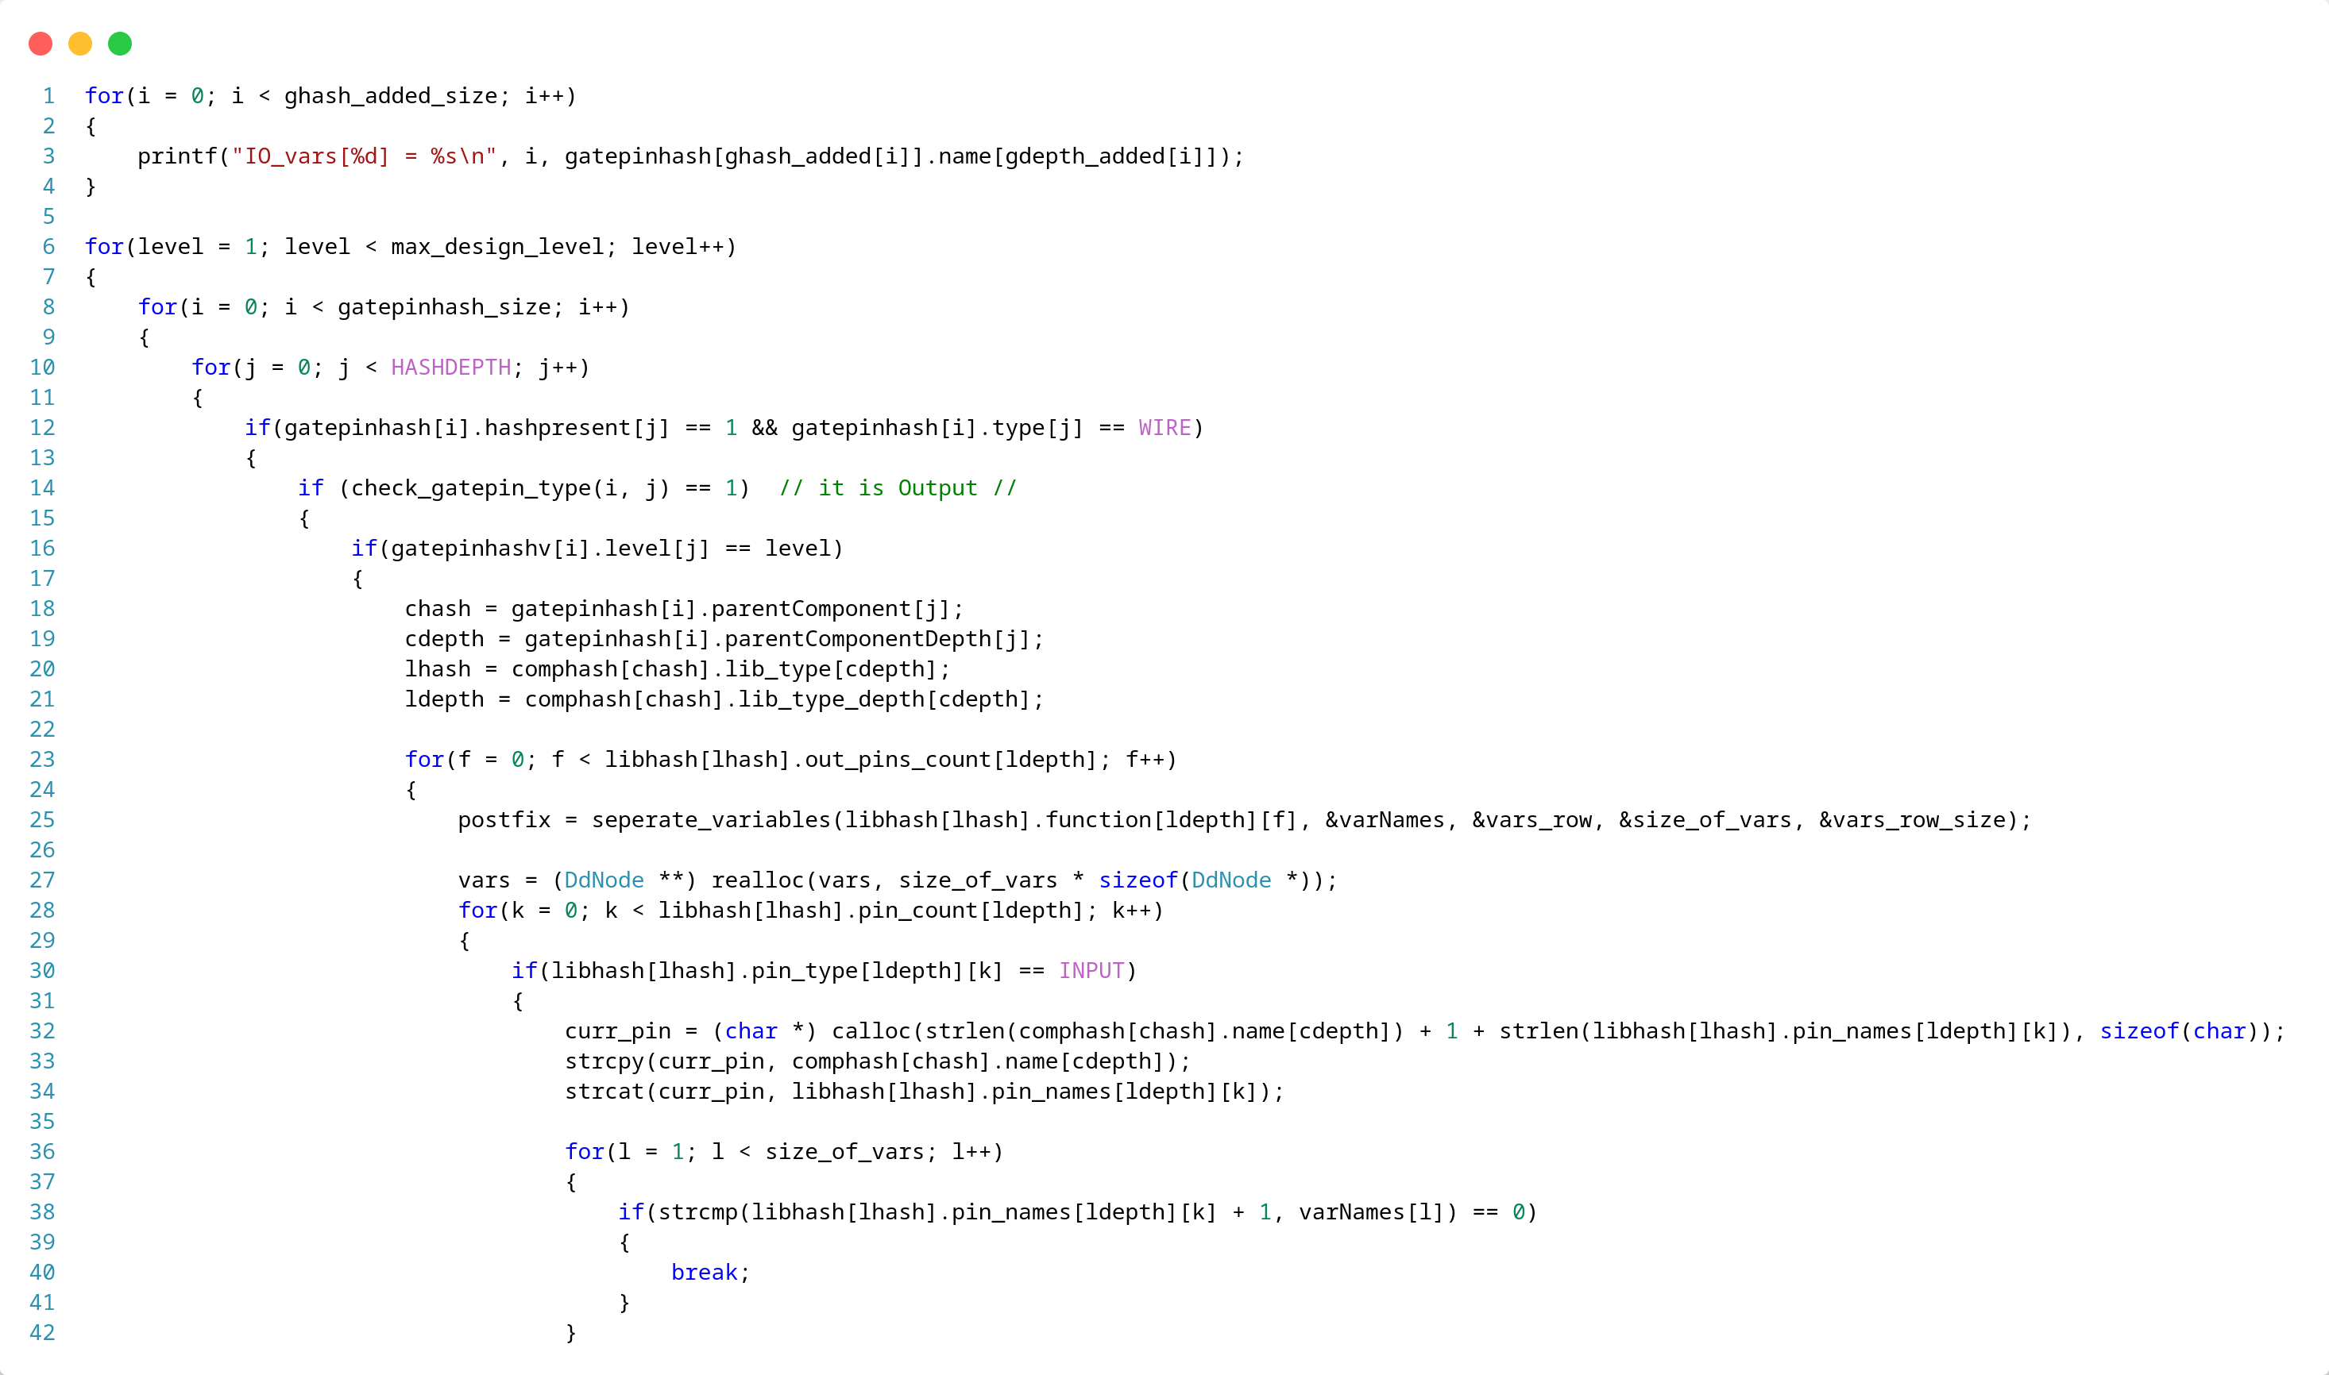
annotate_bdds

Slide 81
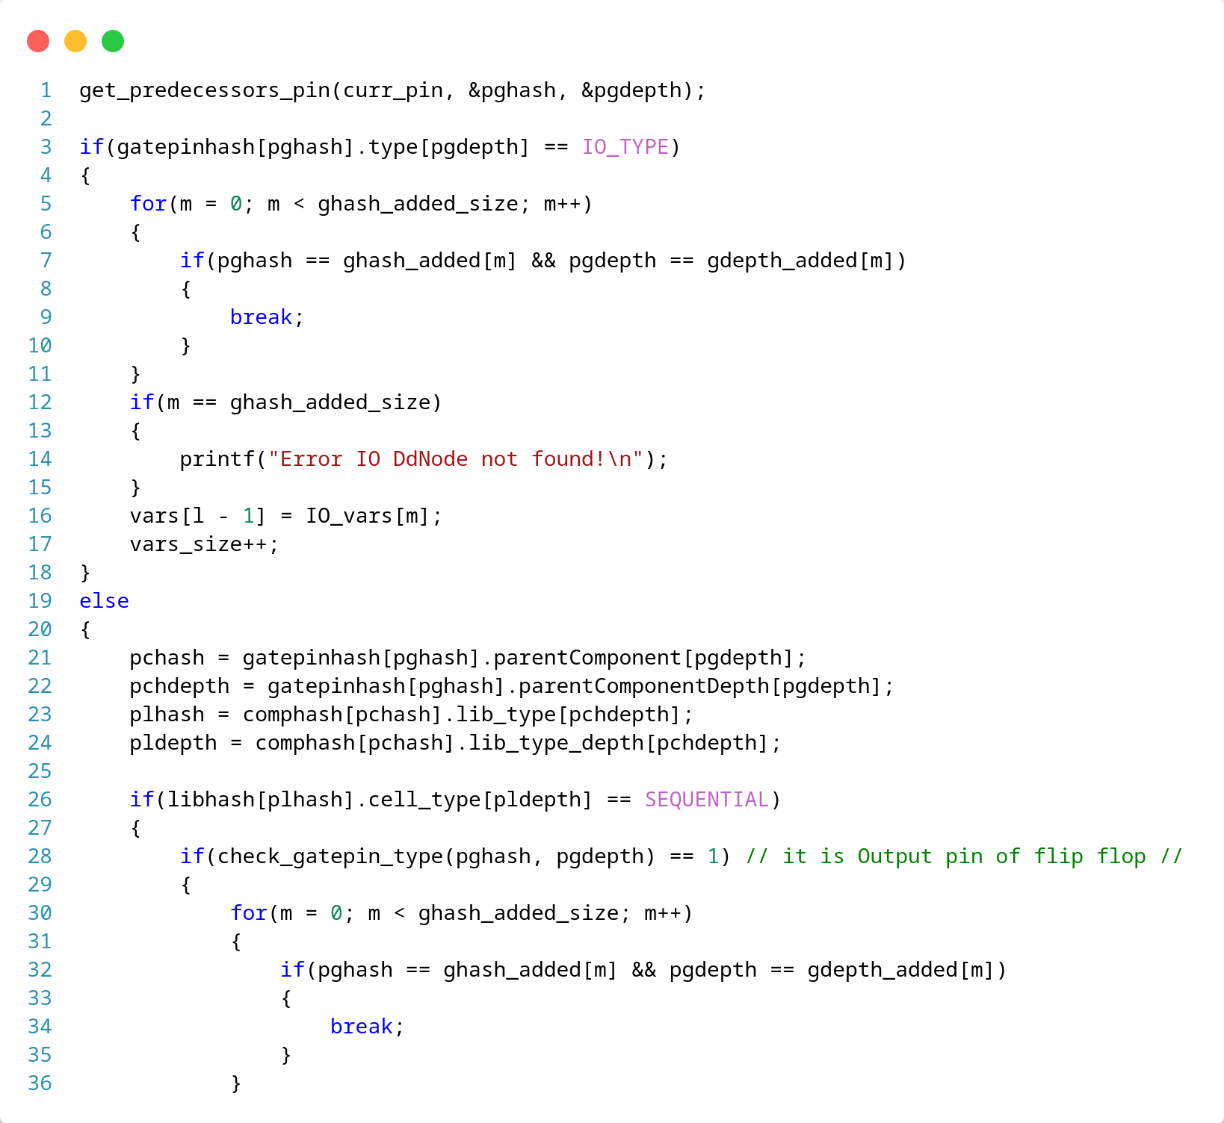
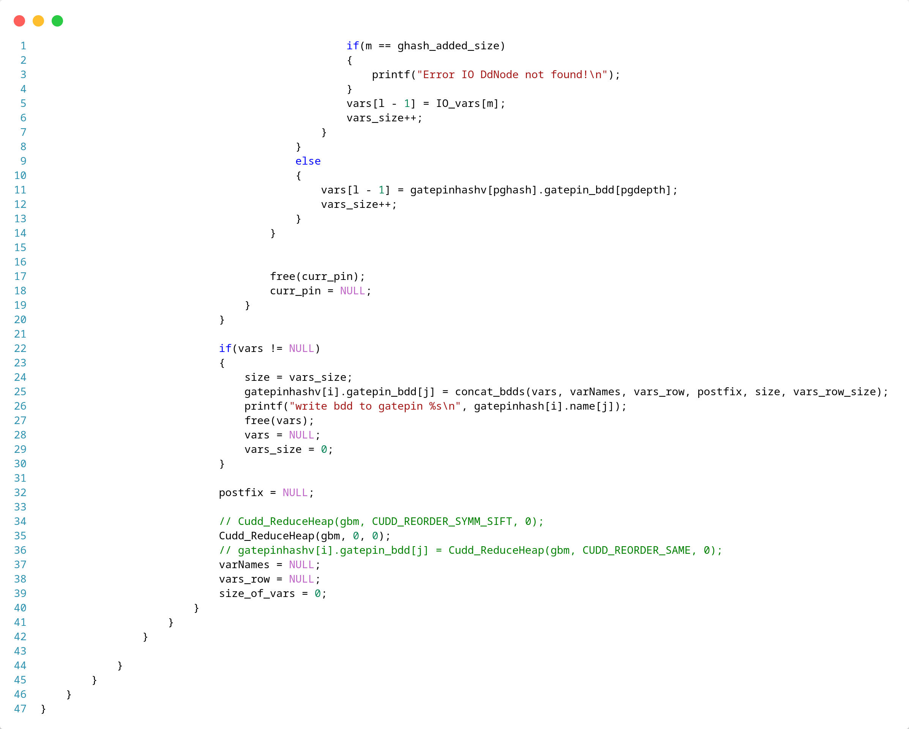
We need to ReduceHeap after each calculation of gatepin
*
*

Slide 82
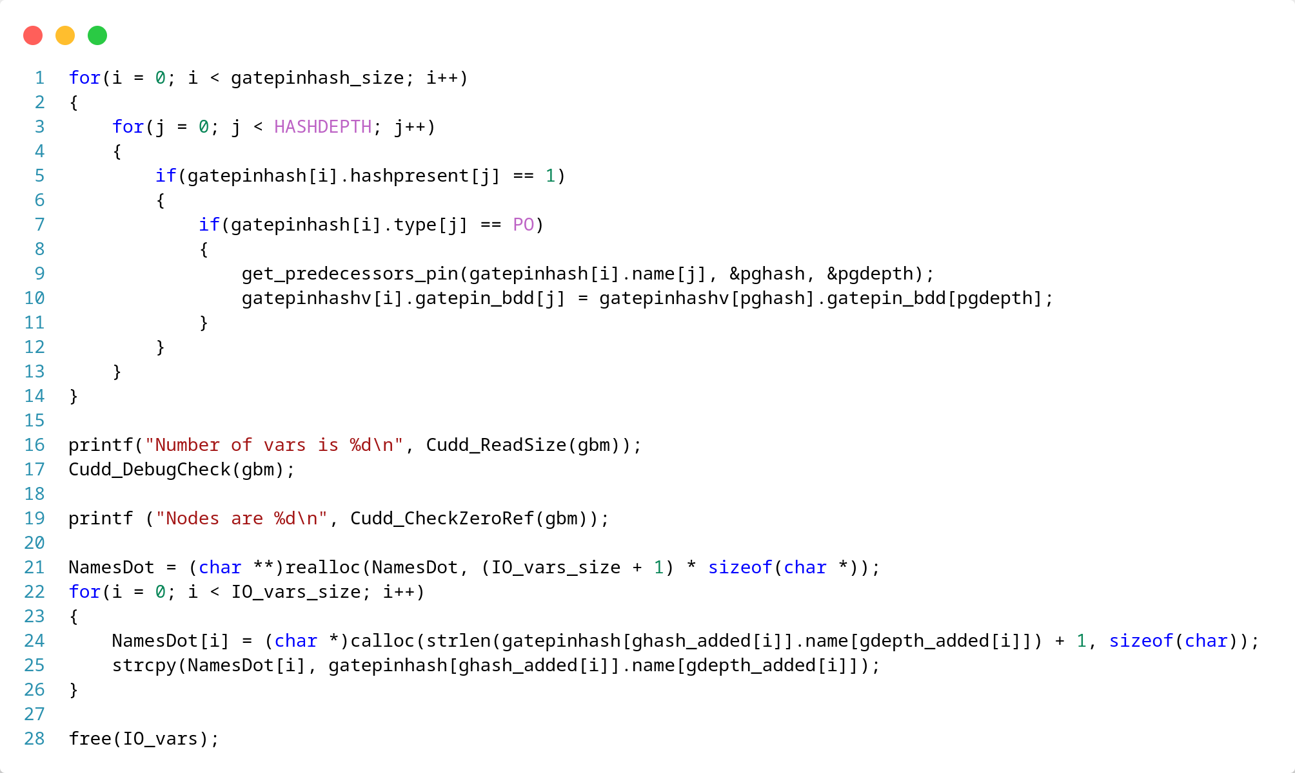
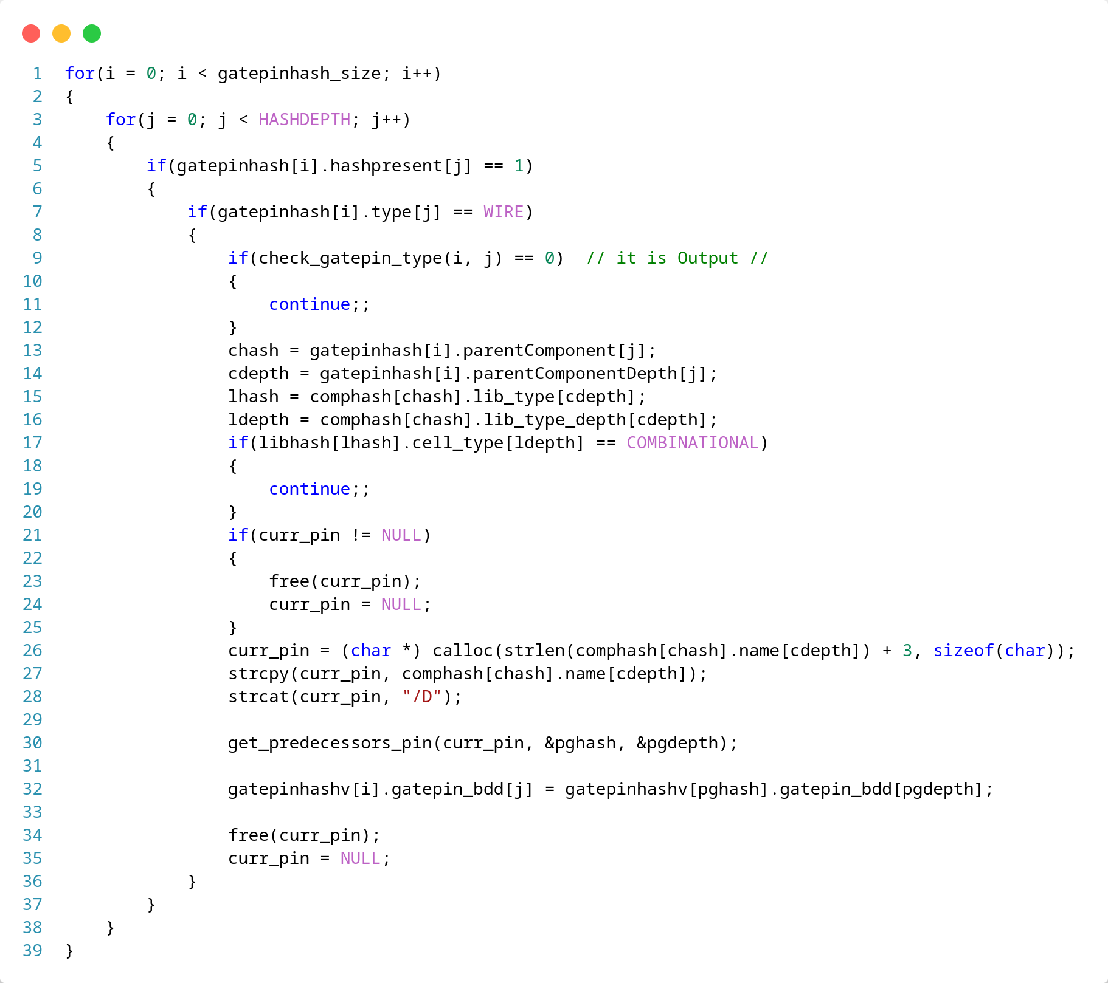
make output of FF same as Input
*
*

Slide 83
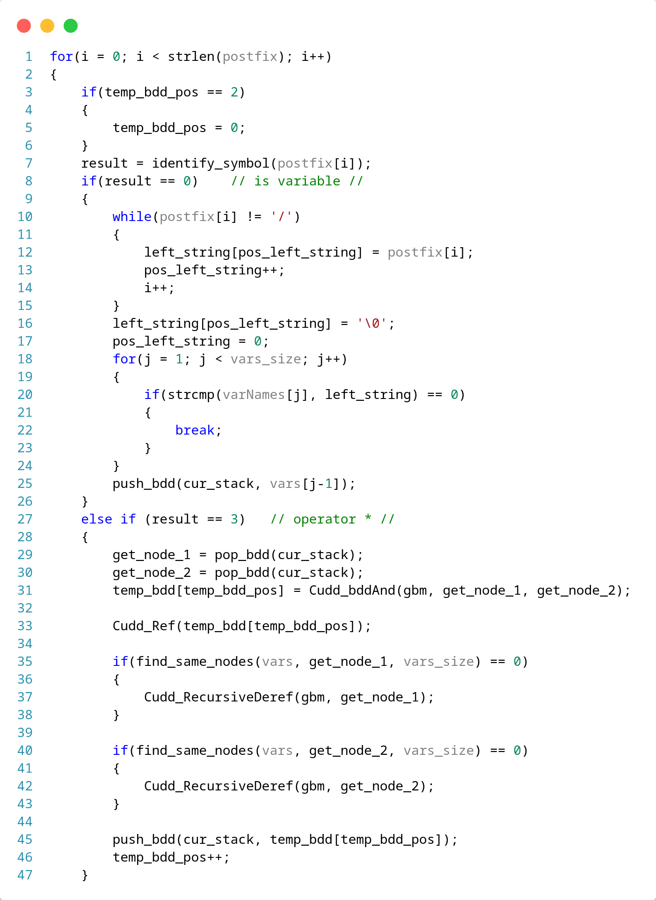
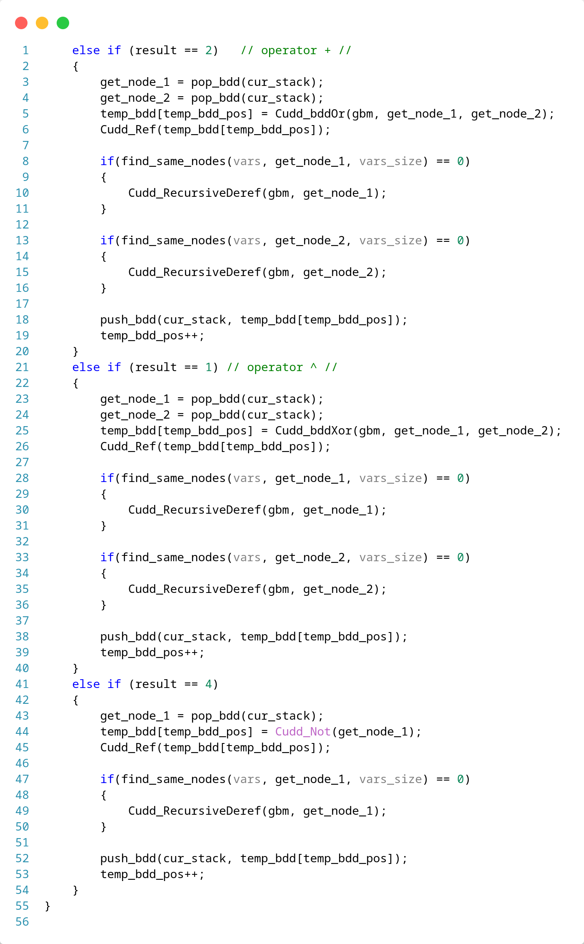
!We use Cudd_Ref and Cudd_recursiveDeref after each boolean calculation to update Nodes

Slide 84
Static Probabilities Annotation
In order to calculate the Probabilities of a BDD we need to traverse all paths of it to constant 1

Slide 85
Static Probabilities Annotation
Steps:
Traverse BDD to get all paths to 1
Keep an array with DdNodes 1-1 in order the variables were created
For each node of path we add either 1 or 0 or - according to side of node (T, E)
Then we multiply probability with (either 1 or 0 ) of node and we add all paths together

Slide 86
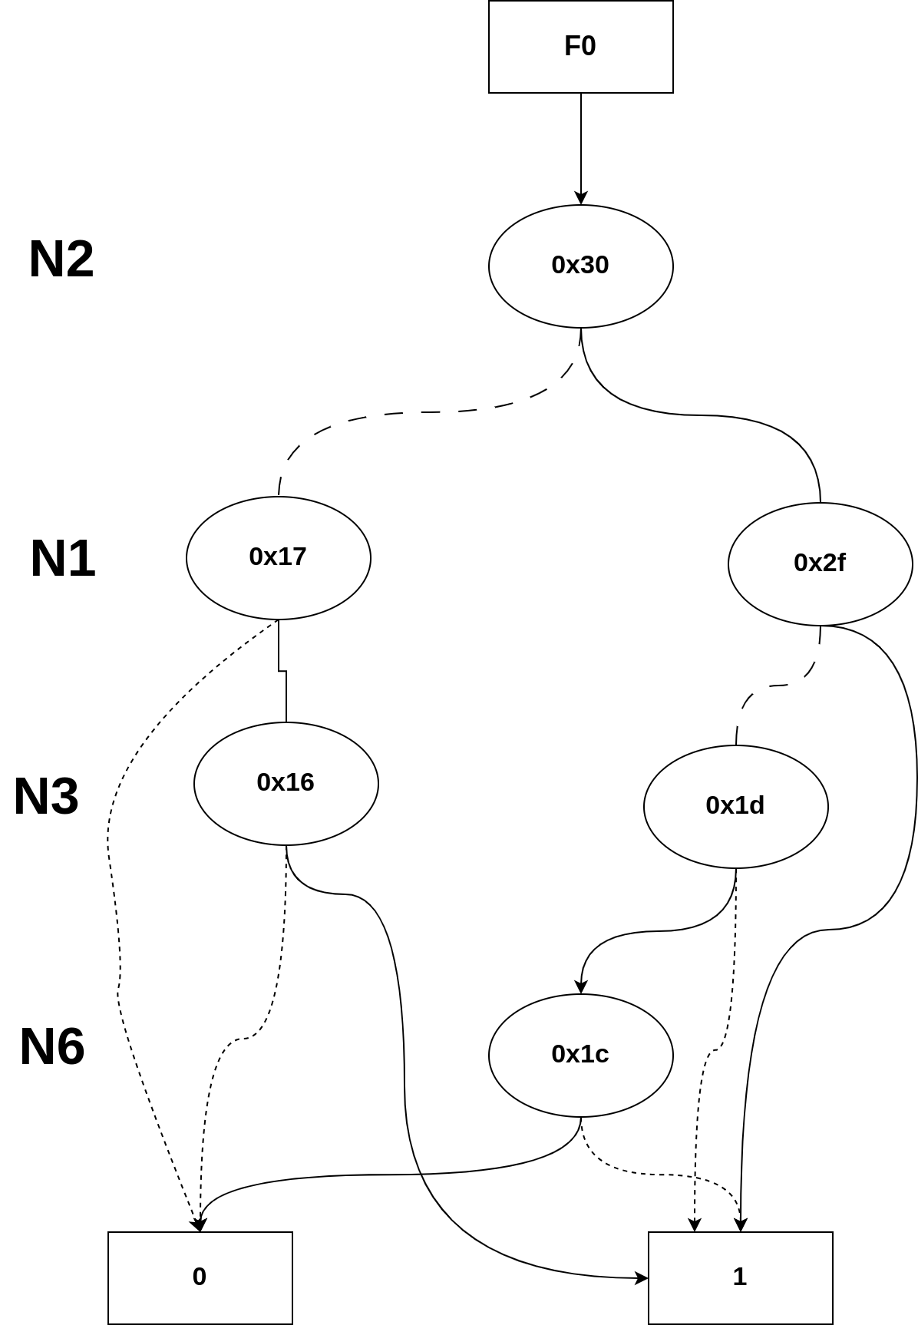
Example of C17/N22
Probability: 1.0
Paths to 1: 4
Number of Minterms: 36

Slide 87
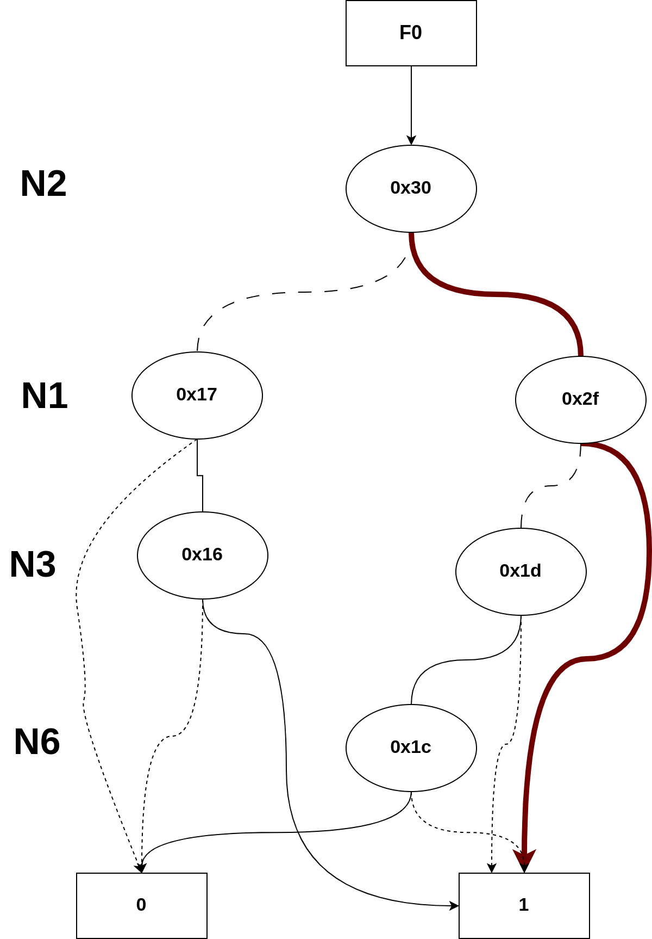
Example of C17/N22
Probability = N2*N1 = 0.05
total_prob = 0.05
Paths to 1: 4
Number of Minterms: 36
0.5 | 0.1 | 0.2 | 0.7
N2 | N1 | N3 | N6
1 | 1 | - | -

Slide 88
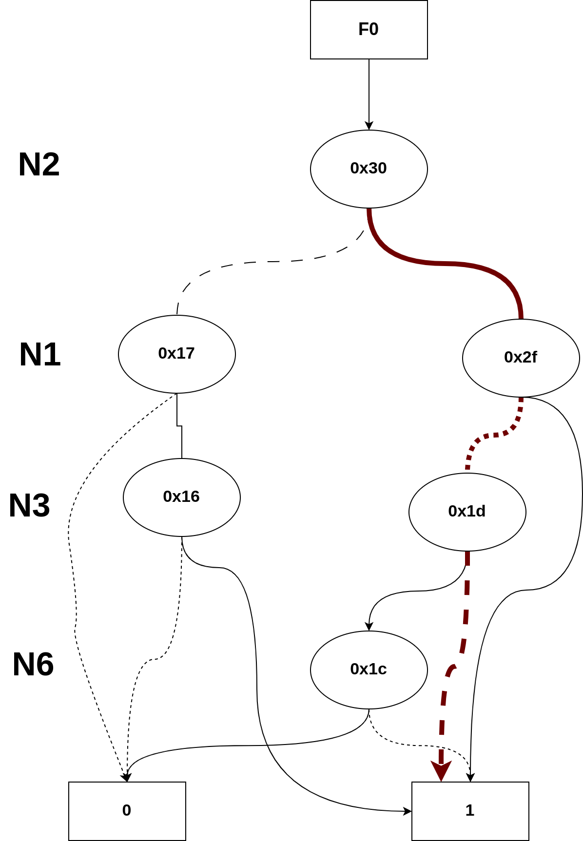
Example of C17/N22
Probability = N2_1*N1_0*N3_0 = 0.36
total_prob = 0.05 + 0.36 = 0.41
Paths to 1: 4
Number of Minterms: 36
0.5 | 0.1 | 0.2 | 0.7
N2 | N1 | N3 | N6
1 | 0 | 0 | -

Slide 89
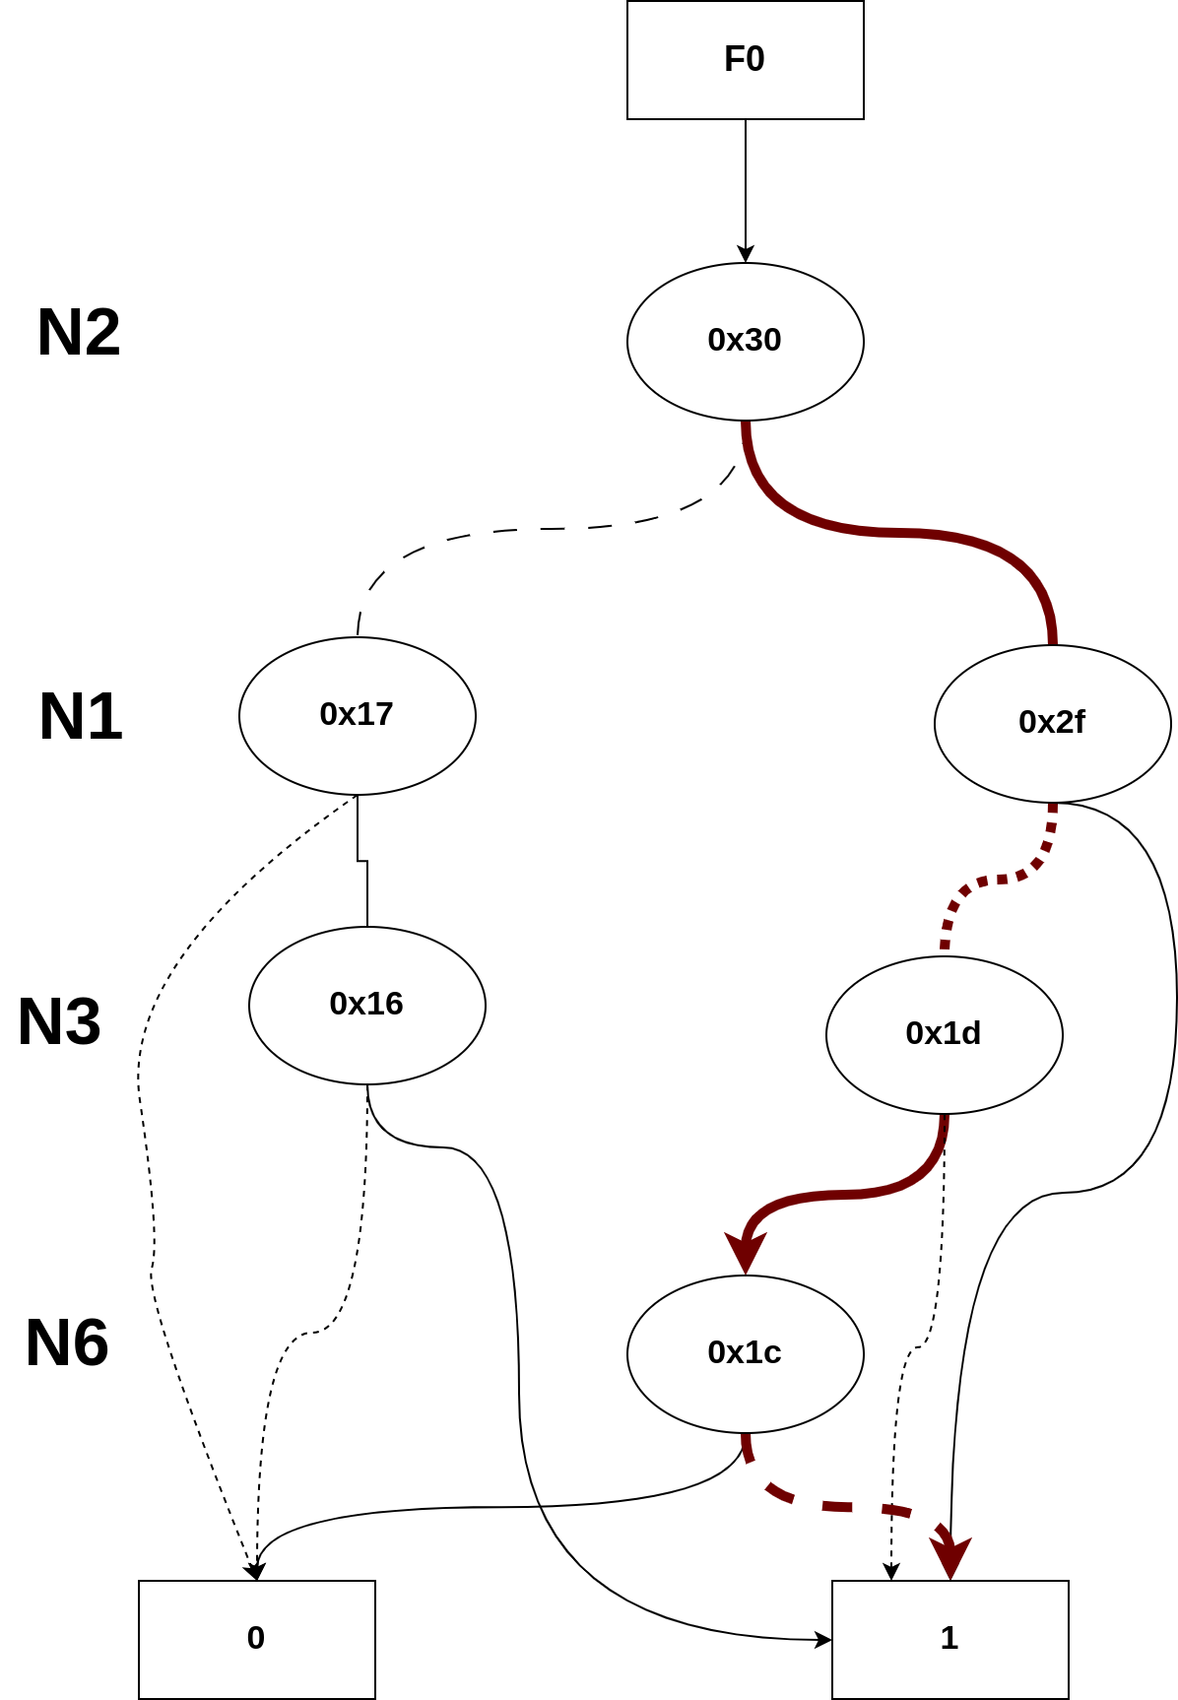
Example of C17/N22
Probability = N2_1 * N1_0 * N3_1 * N6_0 = 0.027
total_prob = 0.41 + 0.027 = 0.437
Paths to 1: 4
Number of Minterms: 36
0.5 | 0.1 | 0.2 | 0.7
N2 | N1 | N3 | N6
1 | 0 | 1 | 0

Slide 90
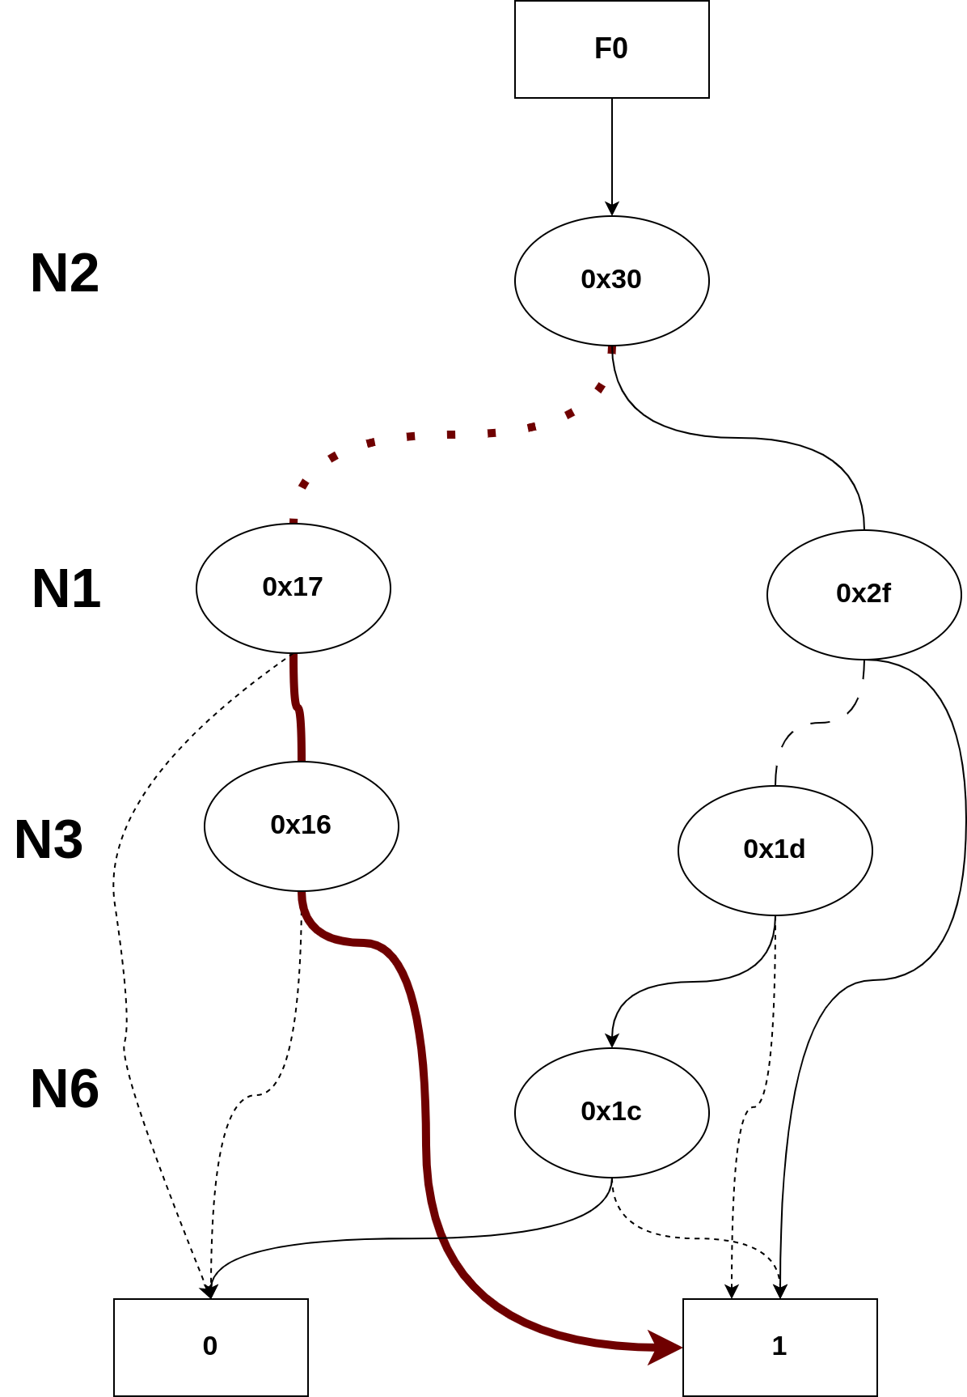
Example of C17/N22
Probability = N2_0 * N1_1 * N3_1 = 0.01
total_prob = 0.437+ 0.01 = 0.447
Paths to 1: 4
Number of Minterms: 36
0.5 | 0.1 | 0.2 | 0.7
N2 | N1 | N3 | N6
0 | 1 | 1 | -

Slide 91
Example of C17/N22
total_prob_to_1 = 0.447
total_prob_to_0 = 0.553

Slide 92
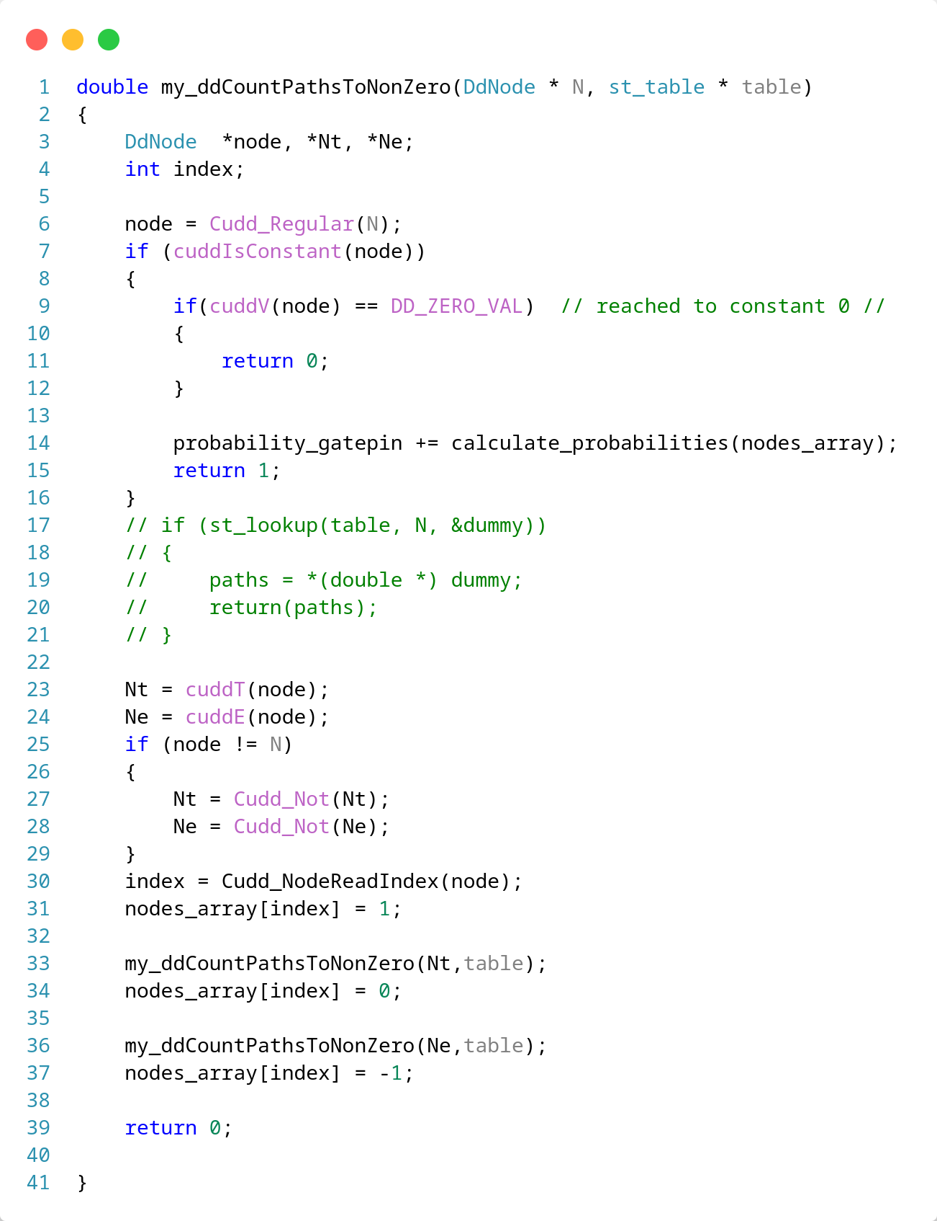
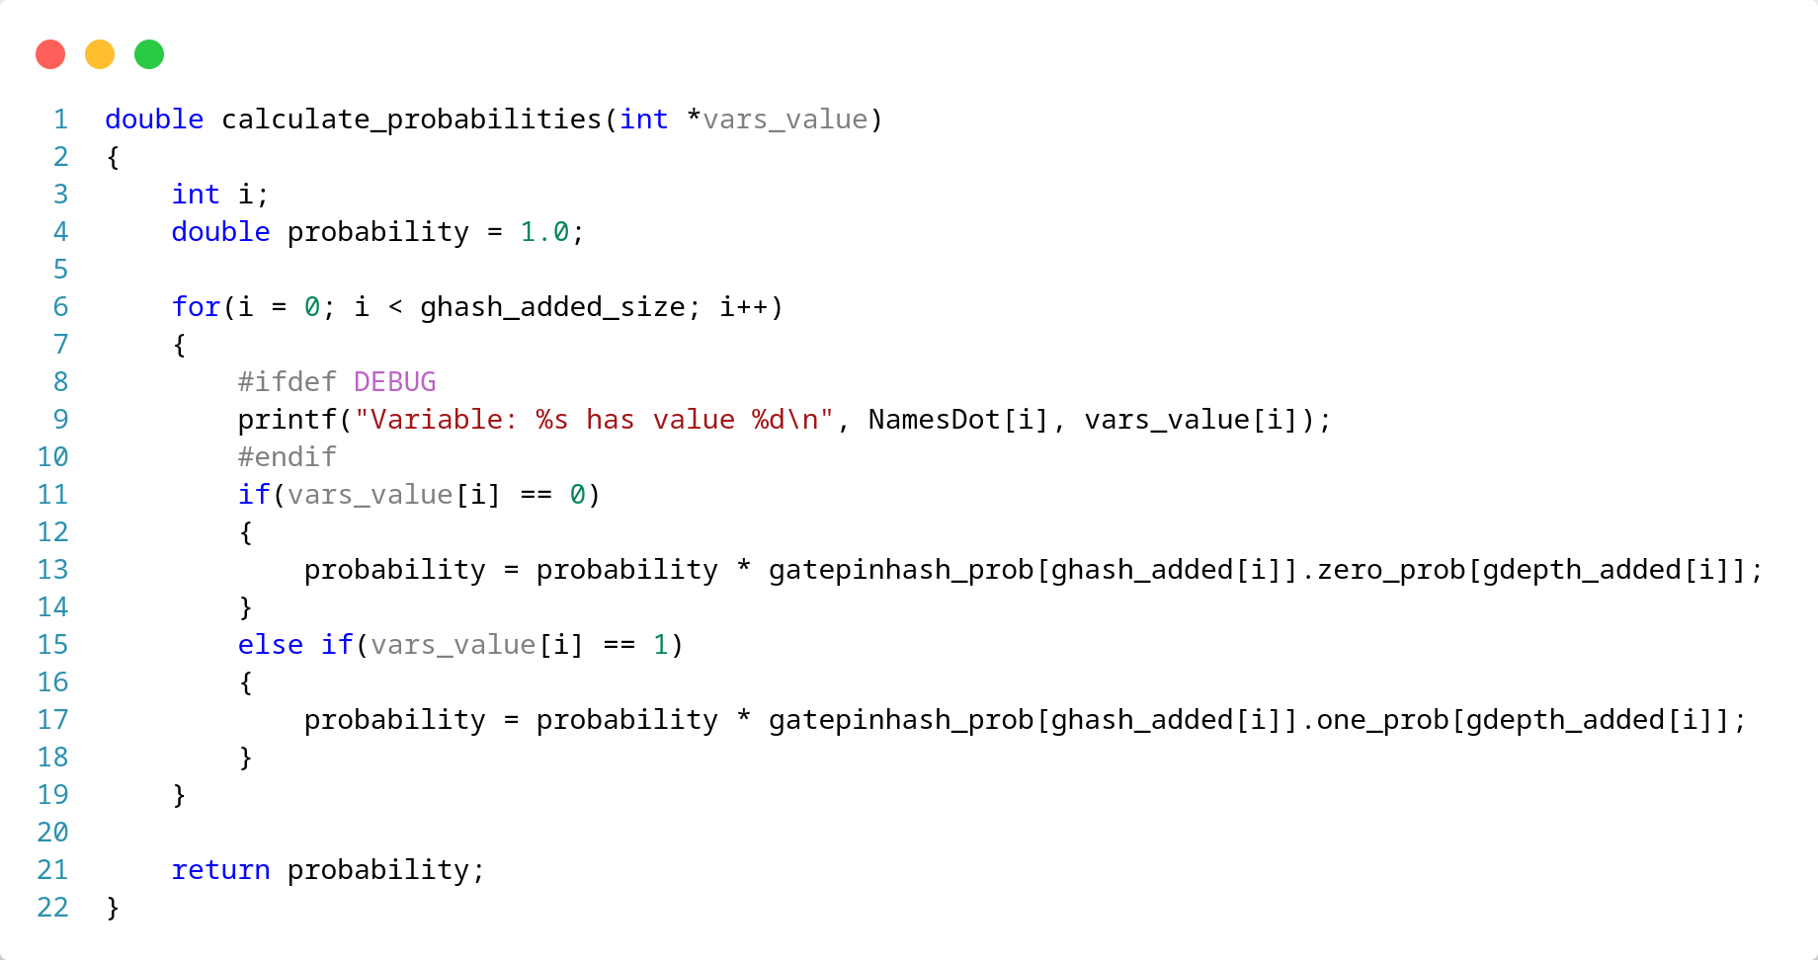
BDD traverse
Probability Calculation
CuddT: for side of Then
CuddE: for side of Else
if node is Not call Cudd_Not for this node
Call Cudd_NodeReadIndex for current node to get position of variable on Array

Slide 93
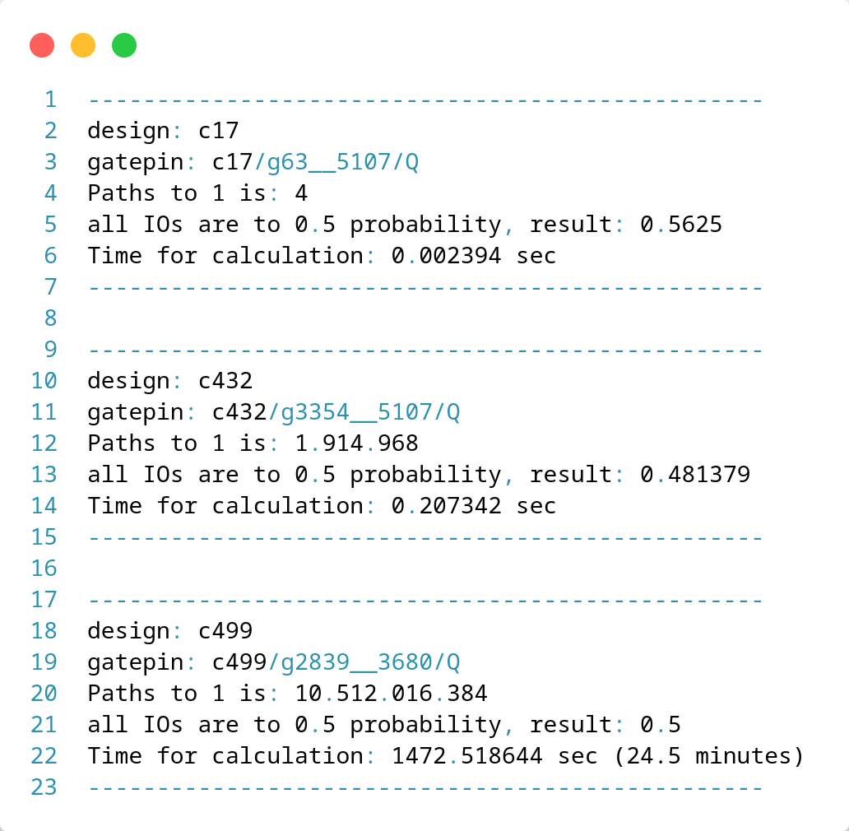
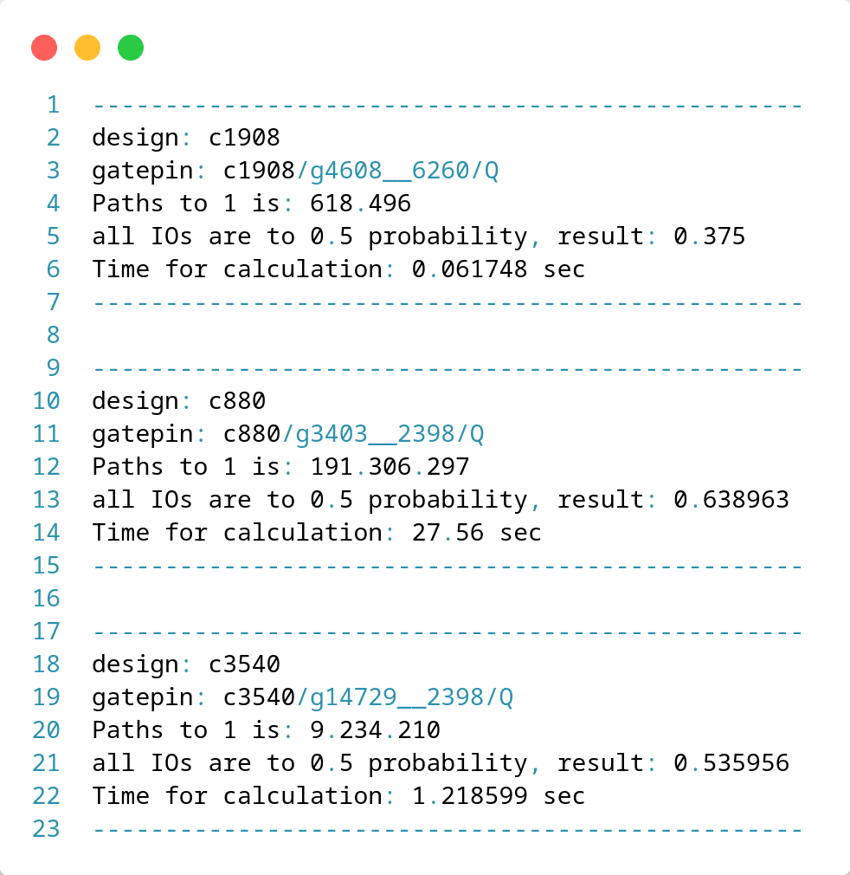
Benchmarks for Probabilities Annotation

Slide 94
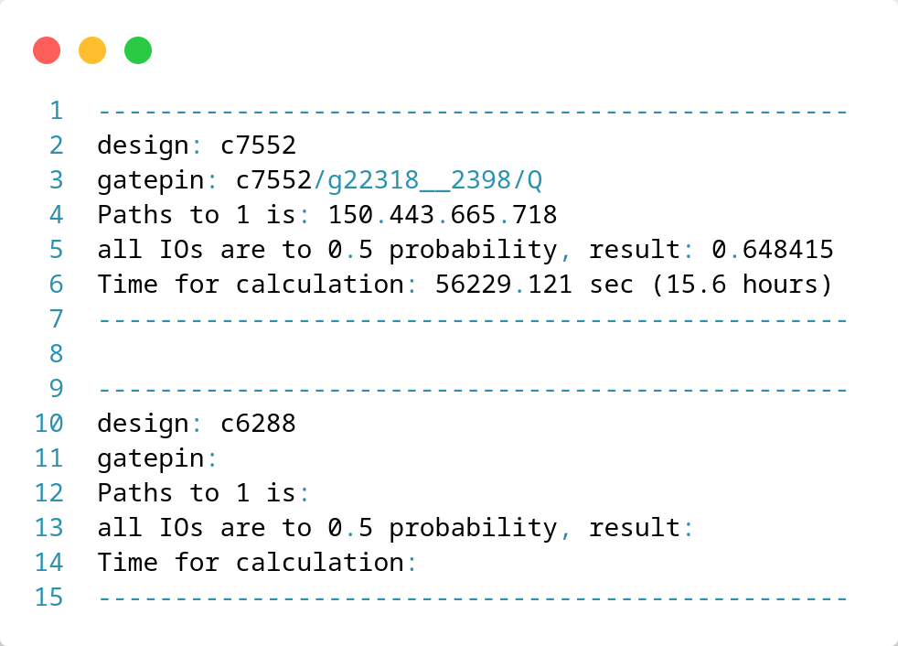
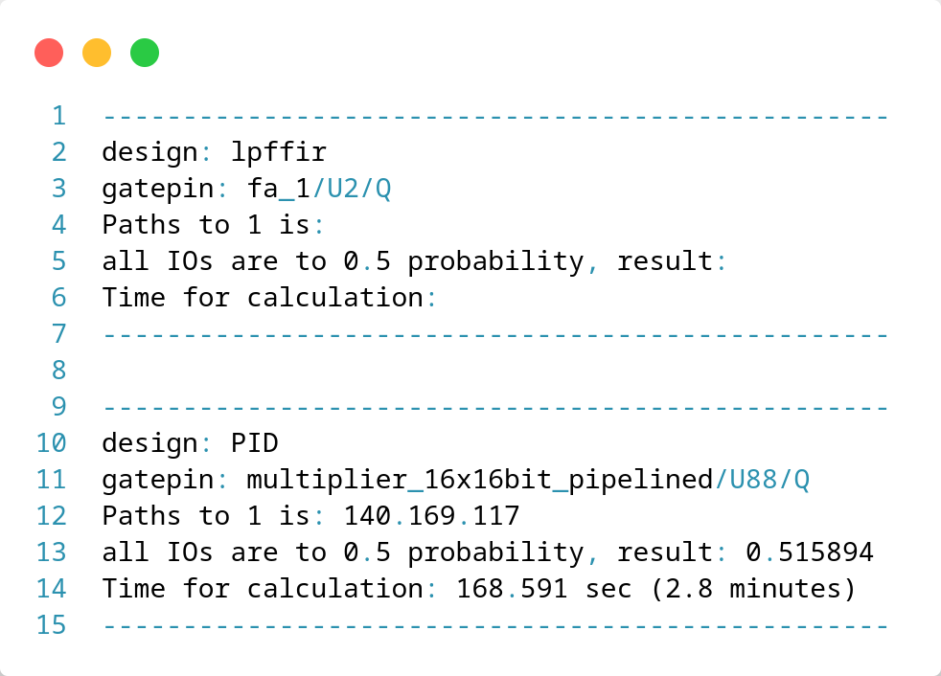
Benchmarks for Probabilities Annotation

Slide 95
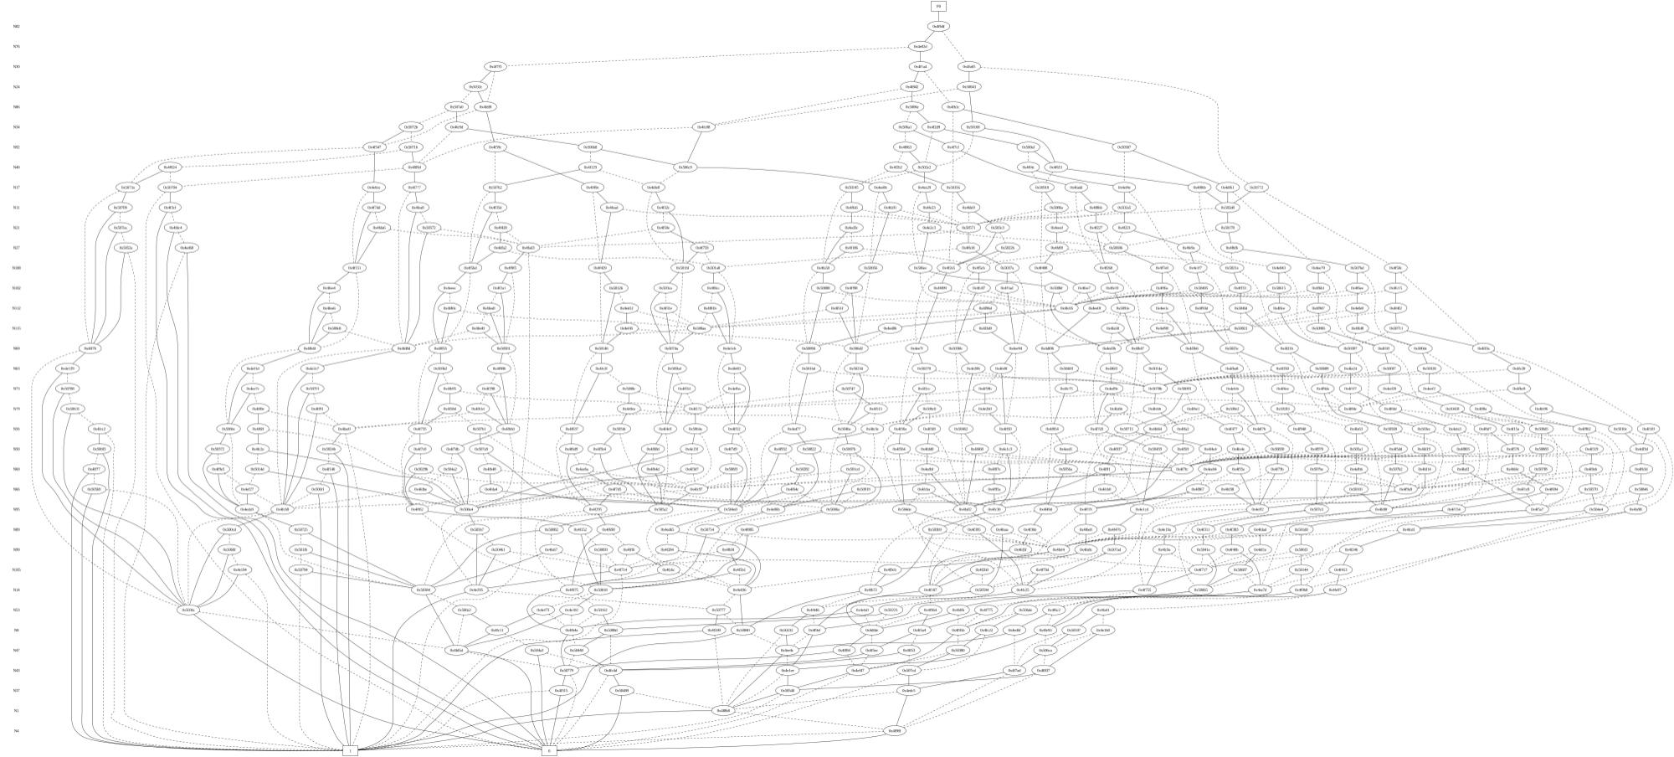
Example for gatepin c432/g3354__5107/Q

Slide 96
Supported TCL Commands
report_bdd_dot_gatepin “gatepin name”
report_bdd_dot_component “component name”
set_static_probability -value “value_to_1” -gatepins {gatepins list} | -allstartpoints
list_static_probability -gatepins {gatepins list} | -allstartoints

Slide 97
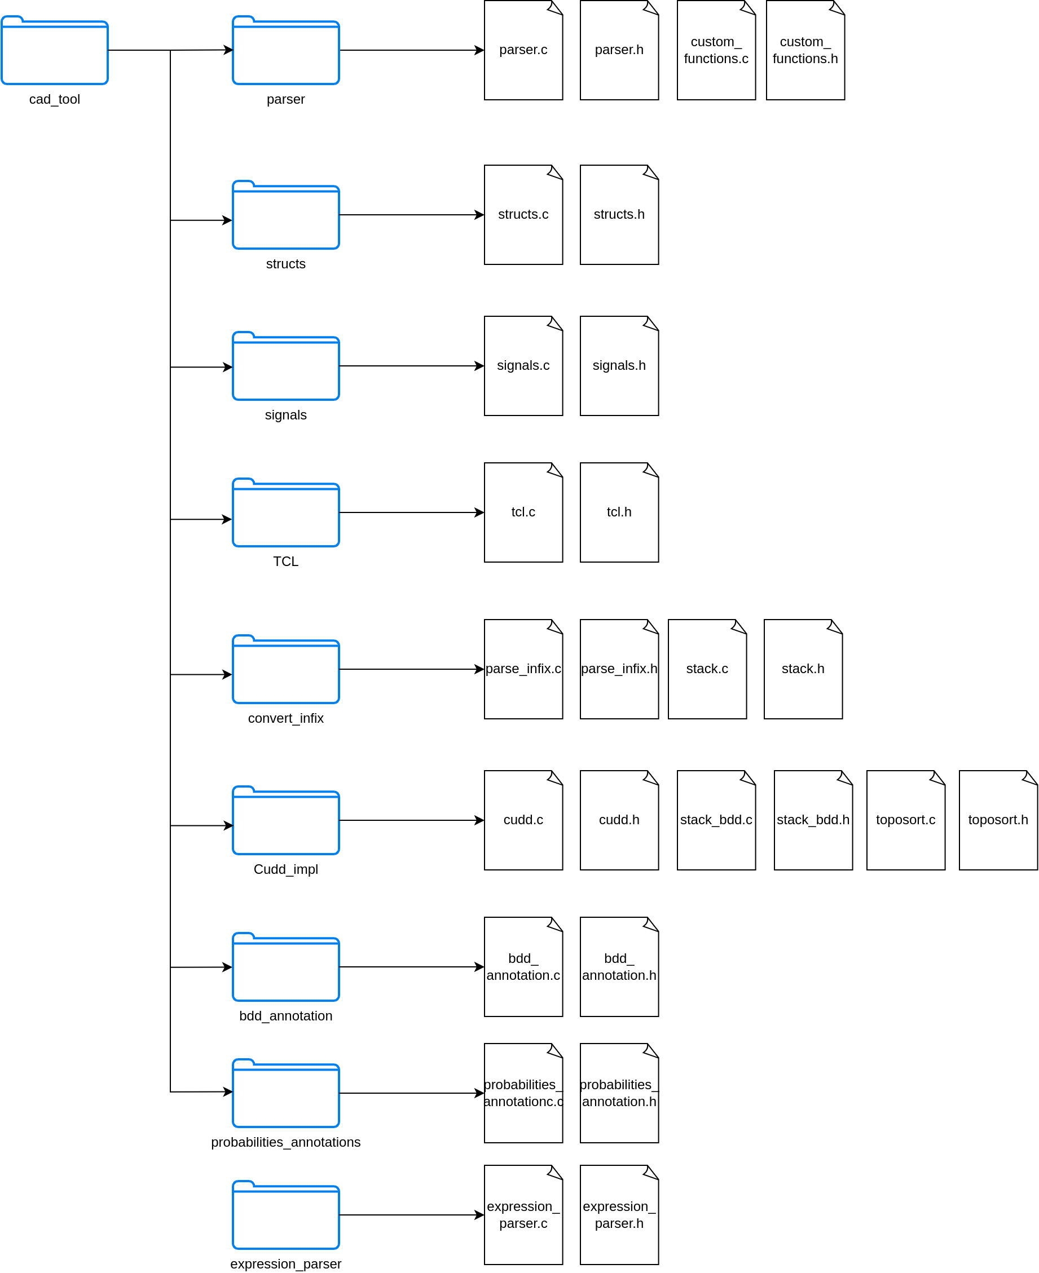
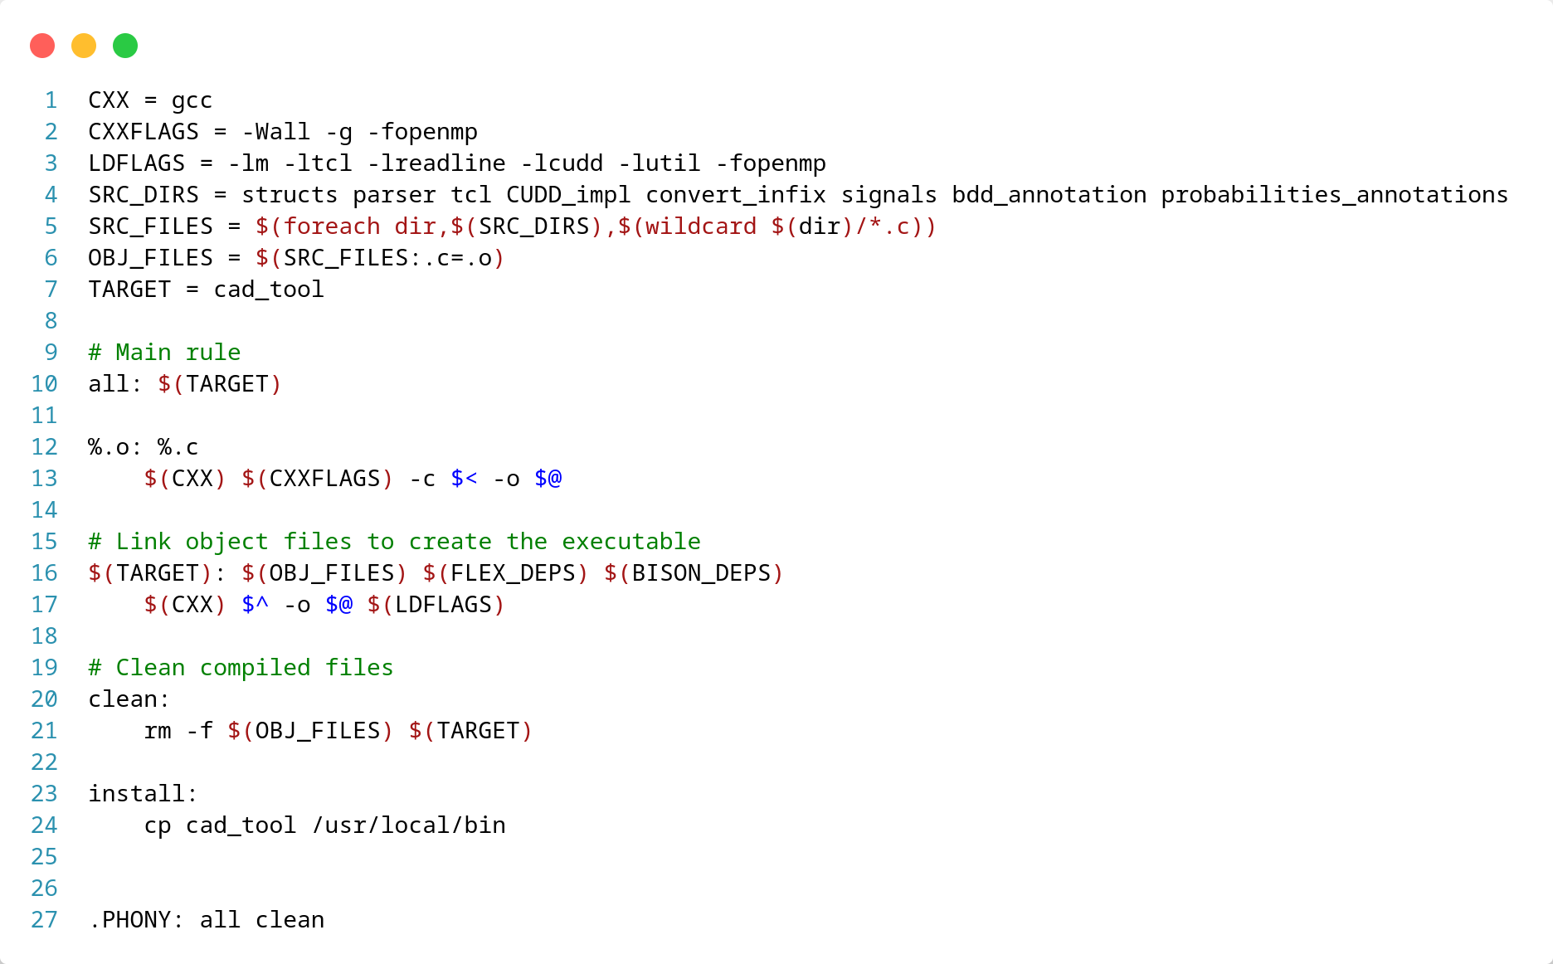
Makefile and Files construction

Slide 98
Demo for HW4
load practicalformat file
get_toposort
annotate_bdd
report_bdd_dot_gatepins “gatepin_name”
set_static_probability -value 0.2 -allstartpoints
list_static_probability -allgatepins

Slide 99

Thank you for your attention!
Do you have any questions?

